Slide 1
IMMIGRATION UPDATE
Presented by:
Becki L. Young, Esq., Hammond Young Immigration Law, LLC Sandra Grossman, Esq., Grossman Law, LLC
El restaurante February 9, 2018
Hammond Young Immigration Law, LLC © 2018

Slide 2
Becki Young
Becki L. Young, co-founder of Hammond Young Immigration Law and head of the firm's Hospitality Practice, is a seasoned business immigration attorney with 20 years of experience in the field. She has represented more than 100 of the world's most prominent hotels and restaurants, and facilitated the sponsorship of foreign professionals, trainees, interns and individuals of "extraordinary ability." In addition to her hospitality practice, Ms. Young regularly provides immigration law advice to clients in a broad range of industries. Ms. Young is an active member of the American Immigration Lawyers Association (AILA). She frequently speaks at legal, business and hospitality conferences, and regularly contributes insight through published articles and commentary. She is highly recommended (Band 3) by Chambers & Partners and recognized as a Leading Legal Practitioner in Corporate Immigration by Who's Who Legal. Hammond Young Immigration Law LLC is rated Tier 1 National and Washington DC for Immigration Law by US News & World Report / Best Lawyers.

Slide 3
Sandra Grossman
Sandra Grossman is the Managing Partner of Grossman Law, LLC, a full-service, immigration law firm operating in Bethesda, Maryland. She is an experienced litigator, having successfully represented individuals in many aspects of immigration law before the immigration courts, Board of Immigration Appeals, and the Federal District Courts. Ms. Grossman represents clients in the area of deportation defense, detention and bond issues, the immigration consequences of criminal convictions, consular processing, requests under the Freedom of Information Act (FOIA), waivers of inadmissibility, asylum, adjustment of status and naturalization applications, and extraordinary ability and artist’s visas, among many other matters.
She is a Former Adjunct Associate Professor in Immigration Law at the Washington College of Law, American University. Ms. Grossman publishes and speaks frequently on the topic of immigration law and is a member of the Editorial Board of Bender’s Immigration Bulletin as well as a regular contributor to the Huffington Post. Ms. Grossman is a Member of the American Immigration Lawyers Association (AILA). She was Vice Chair of AILA’s Asylum and Refugee Committee (2016-2017).
She is a native Spanish and English speaker and is conversant in French.

Slide 4
TPS Termination: What Does it Mean?
* Legal OPTIONs for TPS beneficiaries and their employers
Notes:
(10 min, Sandra)

Slide 5
Legal Options For TPS Beneficiaries and Their Employers
The end of TPS for Salvadorans, Nicaraguans, and Haitians has left many individuals – a substantial percentage of whom work in hospitality and other service industries - scrambling for ways to remain in the United States.
This webinar will discuss practical considerations around the end of TPS, as well as potential legal remedies for those whose status is ending.
Affirmative remedies such as adjustment of status (getting a “green card” or “lawful permanent residency”) through employment or family sponsorship; and,
Defensive remedies for individuals in removal proceedings, and those with previous orders of removal.
Notes:
SG
One is before you get put removal proceedings and one after.

Slide 6
TPS Termination- El Salvador
On January 8, 2018, the Secretary for the Department of Homeland Security (DHS) announced the U.S. Government’s decision to terminate TPS designation for El Salvador.
The termination has been delayed for 18 months, which means TPS benefits will terminate on September 9, 2019.
According to the DHS the 18 months provided will allow “time for individuals with TPS to arrange for their departure or to seek alternative lawful status in the U.S.”
There are approximately 200,000 Salvadorans currently on TPS in the U.S.
Notes:
According to DHS “The decision to terminate TPS for El Salvador was made after a review of the disaster-related conditions upon which the country’s original designation was based and an assessment of whether those originating conditions continue to exist as required by statute.”
The DHS Secretary determined that those original conditions caused by the 2001 earthquake no longer exist.
For example, Nicaragua’s designation for TPS (1999) was based on the devastation caused by Hurricane Mitch, and Haiti’s designation (2010) was based on the 7.0 magnitude earthquake in 2010.
According to the Government’s announcement, the social and economic conditions affected by the natural disasters in these countries are either improving (Haiti) or are stabilized (Nicaragua and El Salvador). As a result, these countries are now able to adequately handle the return of their nationals and no longer have the “extraordinary and temporary conditions” that related to their designations.

Slide 7
What is TPS (Temporary Protected Status)?
TPS is a temporary form of relief for individuals from certain countries designated by the Department of Homeland Security during times of extraordinary or temporary conditions such as armed conflicts or environmental disasters. (TPS is NOT residency, though many TPS beneficiaries have resided for lengthy periods of time in the U.S.)
Current countries that have TPS are El Salvador, Haiti, Honduras, Nepal, Nicaragua, Somalia, Sudan, South Sudan, Syria, and Yemen.
Congress passed legislation which allows TPS beneficiaries to have employment authorization and a temporary lawful status in the U.S.
TPS can be extended by the DHS, as it has been for many countries since 1990.
TPS Recipients must regularly re-register to maintain their TPS status for as long as the designation continues.

Slide 8
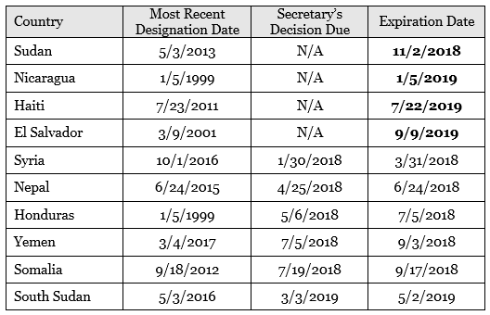
TPS Designation Terminations and Deadlines for Re-registration
Nicaragua: The 60-day registration period for TPS status is from December 15, 2017 – February 13, 2018.
The TPS designation terminates as of January 5, 2019.
El Salvador: The 60-day registration period for TPS status is from January 18, 2018 – March 19, 2018.
The TPS designation terminates as of September 9. 2019.
Haiti: The 60-day registration period for TPS status is from January 18, 2018 – March 19, 2018 .
The TPS designation terminates as of July 22, 2019.
Notes:
*note: On Jan. 31, 2018, Secretary of Homeland Security announced her decision to extend the TPS designation for Syria for 18 months through Sept. 30, 2019.
IMPORTANT THAT PEOPLE REGISTER AS THEY NORMALLY DID TO TAKE ADVANTAGE OF THE EXTENSION.

Slide 9
Immigrant Rights Groups, Faith Organizations, and Others Decry the Decision: What are the Arguments?
Fear that people will be sent back to their countries of origin before they are sufficiently safe for their return.
Country conditions in El Salvador, Nicaragua and Honduras call for continuing to extend TPS.
TPS holders have been in the U.S. for many years; ending TPS divides families.
Terminating the rights and benefits of TPS holders will negatively affect the U.S. economy and U.S. employers.
In January 2017, an estimated 325,000 migrants from 13 TPS-designated countries resided in the United States.
The labor force participation rate of the TPS population from El Salvador, Honduras and Haiti ranges from 81 to 88 percent, which is well above the rate for the total US population (63 percent) and the foreign-born population (66 percent).
The five leading industries in which TPS beneficiaries from these countries work are: construction (51,700), restaurants and other food services (32,400), landscaping services (15,800), child day care services (10,000), and grocery stores (9,200).
Notes:
All statistics derived from “A Statistical and Demographic Profile of the US Temporary Protected Status Populations from El Salvador, Honduras, and Haiti,” Center for Migration Studies (August 2017) available at http://cmsny.org/publications/jmhs-tps-elsalvador-honduras-haiti/.

Slide 10
Affirmative options
Notes:
(20 min, Becki)

Slide 11
Alternative Forms of Relief for TPS Holders
The best option for TPS holders would be a legislative solution
ONLY the U.S. Congress can legislate a permanent solution
S. 2144: Safe Environment from Countries Under Repression and Emergency Act
On 11/16/17, Senator Chris Van Hollen (D-MD) introduced the Safe Environment from Countries Under Repression and Emergency (SECURE) Act (S. 2144), which would allow the adjustment of status to lawful permanent resident to nationals granted TPS status.
H.R. 4384: ASPIRE-TPS Act of 2017
On 11/14/17, Representative Yvette Clarke (D-NY) introduced the ASPIRE-TPS Act of 2017, which would allow certain nationals granted or eligible for TPS/DED status as of 1/1/17 to be granted protected status for a renewable six-year period and permit adjustment in cases of extreme hardship.
H.R. 4253: American Promise Act of 2017
On 11/3/17, Representative Nydia Velázquez (D-NY) introduced the American Promise Act of 2017 (H.R. 4253) to provide individuals who currently receive TPS and DED, and have resided in the U.S. under these programs for a period of three years, the ability to apply for lawful permanent residence.
Lobby Your Congress Members for Comprehensive Immigration Reform

Slide 12
Adjustment of Status
Lawful Permanent Residency = a “Green Card”
What is it? Obtaining a green card or lawful permanent residency in the U.S. A person that has residency can travel and work in the U.S. without prior authorization.
Residents have the same rights as citizens though they can’t vote in local state or federal elections. They are also deportable from the U.S. for the commission of certain crimes or other acts.
Leads to citizenship: A person that has residency can apply for citizenship in either 3 or 5 years.
Whether someone with TPS will be eligible for adjustment of status depends on 1) where they are located in the U.S., and 2) the individual facts of their case (for example if they are deportable on any other grounds, such as for criminal reasons or if they have a prior order of deportation from a an immigration judge).

Slide 13
Who is Eligible for Adjustment of Status?
“Admission and Inspection” or “Parole”
Generally, in order for someone to apply for a green card, that person must have been inspected and admitted or paroled in the U.S.
Parole is when someone enters the country lawfully such as for humanitarian reasons or after they have been granted travel authorization.
Admission generally occurs when someone presents themselves at a port of entry with valid immigration documents (such as a tourist visa or work visa) and is formally admitted to the U.S.
*Most TPS holders were not formally admitted to the U.S. Most entered without inspection by illegally crossing a U.S. border. So, unless they travelled with Advance Parole (or travel authorization) they will not lawfully “admitted,” unless they reside in U.S. states where the grant of TPS is considered an admission.

Slide 14
Adjustment of Status through Employer-based Petition

Slide 15
The PERM Process
Step One: Employer Files Application for Alien Employment Certification (“Labor Certification”) with the Department of Labor (“DOL”)
Employer conducts recruitment for the position, including two Sunday newspaper advertisements, a job order with the State Workforce Agency, and a posting on the business premises – For professional positions, employer must complete at least 3 additional recruitment steps
Employer files labor certification application electronically using DOL’s online PERM system
DOL reviews labor certification application – If DOL believes that additional information is necessary, or that there is a problem with the case, they may conduct an audit
DOL forwards approved labor certification application to employer

Slide 16
Step Two: Employer Files Immigrant Visa Petition with the Immigration Service

Slide 17
Step Three: Foreign National Employee Requests Permanent Resident Status (Two Options)
Option one: Foreign National Files Application for Adjustment of Status with the Immigration Service
Applicants receive employment authorization document (EAD) in about 3-5 months
“I-140 Portability” (change to new job in same or similar occupation) allowed after 180 days.

Slide 18
Option two: Foreign National Files Request for Consular Processing of Immigrant Visa with U.S. Overseas Consular Post
• Advantage
For all countries where foreign national has lived for more than 6 months after the age of 16, must provide residential addresses and obtain police clearances.
If in US:
No work authorization granted during the process.
When final interview is scheduled, foreign national must travel to home country (with dependent family members) on short notice of 3-4 weeks and remain in home country for about one week to complete final interview procedures.

Slide 19
Adjustment of Status through U.S. citizen Immediate Relative

Slide 20
Step One:
U.S. Citizen or legal permanent resident spouse files immigrant visa petition with the immigration service
• The U.S. citizen or legal permanent resident spouse must show that s/he is a U.S. citizen or legal permanent resident and that s/he has entered into a good faith marriage with the foreign national spouse. Documents evidencing a good faith marriage must be submitted (such as documentation showing joint ownership of property; lease showing joint residence; evidence of joint bank accounts, tax returns, credit cards, utility bills and phone bills; wedding photographs; etc.).
• Upon approval of the immigrant visa petition, spouses of U.S. citizens can proceed immediately to Step Two (or can file Step Two concurrently with step one if using Option Two). Spouses of Legal Permanent Residents, however, must wait until their “priority date” becomes current (see the “Visa Bulletin” at travel.state.gov for more information).

Slide 21
Step Two:
Foreign national spouse requests permanent resident status, through adjustment of status or consular processing

Slide 22
245i Adjustment
Enables certain individuals who are present in the United States who would not normally qualify to apply for adjustment of status in the United States to obtain a green card (permanent residence) regardless of:
The manner they entered the United States
Working in the United States without authorization
Failing to continuously maintain lawful status since entry
To qualify for this provision, you must be the beneficiary of a labor certification application (Form ETA 750) or immigrant visa petition (Forms I-130, Petition for Alien Relative or I-140, Immigrant Petition for Alien Worker) filed on or before April 30, 2001. In most cases, you must pay an additional $1,000 fee and complete Supplement A to Form I-485, Application to Register Permanent Residence or Adjust Status, to apply under Section 245(i) provisions with your adjustment of status application (Form I-485).

Slide 23
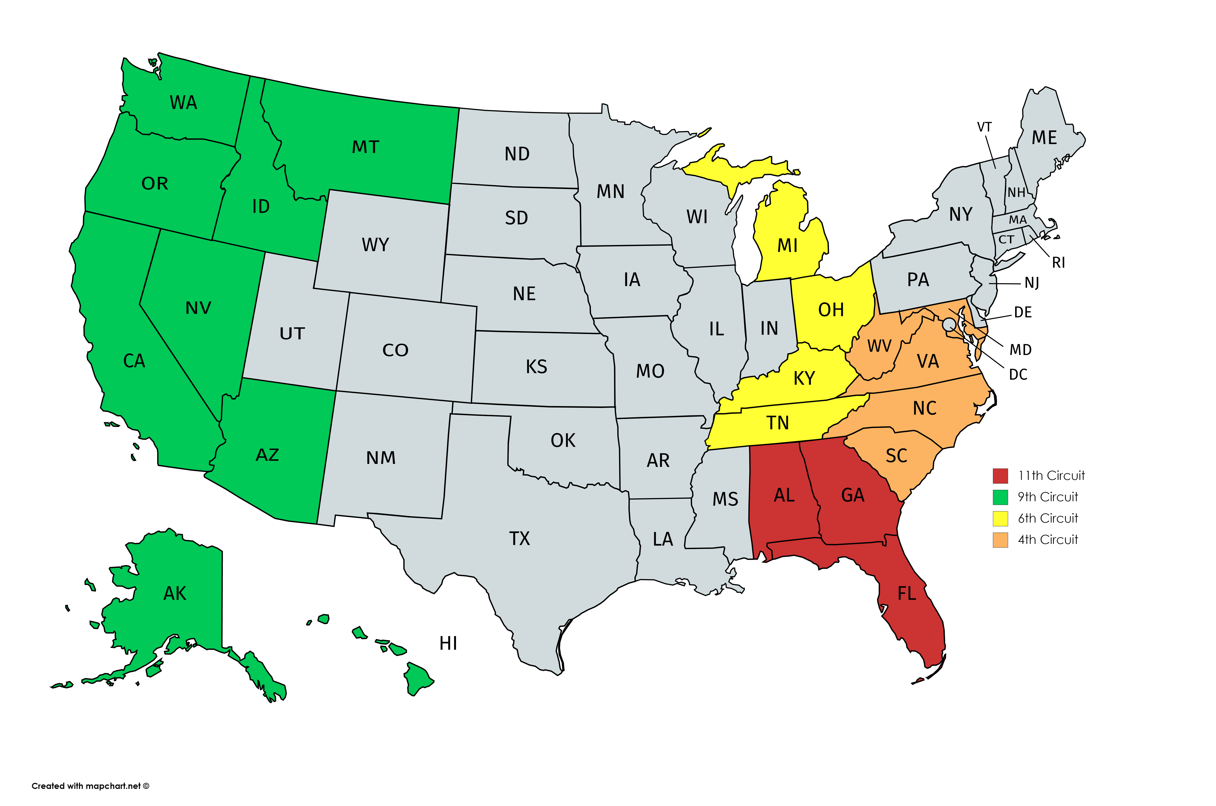
TPS Beneficiaries in the 6th and 9th Circuits Are In a More Favorable Position to Get their Residency Approved
Notes:
6th circuit includes Kentucky, Michigan, Ohio, and Tennessee.
9th Circuit includes Alaska, Arizona, California, Hawaii, Idaho, Montana, Nevada, Oregon, and Washington.

Slide 24
TPS Beneficiaries in the 6th and 9th Circuits Are In a More Favorable Position to Have their Residency Approved
Why? Because TPS IS AN “ADMISSION” FOR PURPOSES OF ADJUSTMENT OF STATUS OR OBTAINING A “GREEN CARD”
Under U.S. immigration law, a person cannot obtain residence unless they were “inspected and admitted or paroled” into the U.S. (this means they either entered on a visa and overstayed or have traveled with authorization since they obtained TPS)
Persons who entered illegally, have never been “inspected and admitted or paroled.”
In Ramirez v. Brown (9th Circuit) and Flores v. USCIS (6th Circuit) the Courts have found that a grant of TPS status constitutes an “admission” for purposes of adjustment of status.
An individual with TPS status who initially entered without inspection satisfies the statutory requirement.
Notes:
Is a TPS recipient who entered without inspection and is living in a state within the jurisdiction of the Ninth or Sixth Circuits automatically eligible for adjustment? No. Even under Ramirez and Flores, an applicant must be otherwise eligible for adjustment. Applicants for adjustment must satisfy three eligibility requirements under INA § 245(a): he or she must • have been inspected and admitted or paroled into the United States; • be eligible to receive a visa and not inadmissible to the United States; and • have a visa is immediately available.
Additionally, an adjustment applicant cannot adjust if barred under any ground listed in INA § 245(c). Relevant here, an applicant is barred if he or she: • worked without authorization prior to applying for adjustment; • is in unlawful immigrant status on the date the adjustment application is filed; or • failed to maintain a lawful status since entry into the United States. Immediate relatives are exempted from the unlawful status and employment bars. Id. 7 A modified rule is applied to certain employment-based adjustment applicants. INA § 245(k).
Employment-based cases: A limited number of TPS recipients who entered without inspection may be eligible to adjust status pursuant to an employment-based visa category. Pursuant to INA § 245(k), individuals eligible for a visa under the 1st through 4th employment preference categories are not subject to the § 245(c) bar to adjustment for unlawful status or unauthorized employment. Instead, these individuals are eligible to adjust if they: o are present in the United States pursuant to a lawful admission on the date of applying for adjustment; and o subsequent to such admission, have not—for an aggregate period of more than 180 days—failed to maintain lawful status, engaged

Slide 25
TPS Beneficiaries in the Remaining Circuits
In contrast, in Serrano v. United States Attorney General (11th Circuit) the court held a grant of TPS does not constitute an admission.
11th Circuit includes Alabama, Florida, and Georgia.
In the remaining states/ federal judicial circuits, whether a grant of TPS status is considered an "admission" remains an open question, ripe for a judicial challenge.
Notes:
In Serrano v. United States Attorney General, 655 F.3d 1260 (11th Cir. 2011), the Eleventh Circuit held that a grant of TPS was not an admission for purposes of adjustment under § 245(a). Thus, TPS recipients living within the states of the Eleventh Circuit are barred from adjusting if they entered without inspection, unless they can satisfy the requirements of INA § 245(i).

Slide 26
Proposed Judicial Strategy: For Individuals Outside the 6th and 9th Circuits
Employers and Family Members May Want to File Petitions on Behalf of TPS Beneficiaries under the Argument that they have been “admitted” for purposes of Adjustment of Status (Green Card)
TPS beneficiaries who have U.S. citizen family members (spouse, parents, or children over 21), who entered on a parole, may file adjustment of status applications.
Individuals with TPS who are otherwise eligible to adjust may move to the Ninth or Sixth Circuits in order to adjust status.
Employers may file petitions for TPS Beneficiaries based on 6th and 9th circuit case law. Employers must understand there are no guarantees.
Best to move quickly.
Notes:
clients with TPS who are otherwise eligible to adjust may move to the Ninth or Sixth Circuits in order to adjust status.

Slide 27
Other Possible Options are Dependent on the Facts of the Individual’s Case
FOR TPS HOLDERS NOT IN REMOVAL PROCEEDINGS
Asylum/Withholding/CAT
Eligible for U visa
Eligible for T visa
I-601 Provisional Waiver
Deferred Action based on compelling humanitarian reasons (filed with USCIS Director)
Notes:
With the announcements by the Administration that TPS is ending for all of these countries, it becomes important to screen TPS beneficiaries for other forms of relief. This really requires thoughtful and often complicated analysis and TPS beneficiaries and possibly their employers will need to meet with immigration counsel to review the facts of their individual cases.
For TPS holders NOT in removal proceedings:
The countries where TPS beneficiaries are from face significant problems in terms of instability, crime, and political upheaval. Asylum may exist as an option for persons from those countries, but these claims will face significant challenges. Not least that asylum seekers must generally submit their applications within one year of entering the U.S. There are exceptions to this rule, including having been in another lawful status in the intervening years, but it will still present a challenge.
Law enforcement visas
Waivers
Some very limited discretionary relief available.
For people to understand their options they need to speak to an immigration attorney.

Slide 28
Other Possible Options are Dependent on the Facts of the Individual’s Case
FOR TPS HOLDERS IN REMOVAL PROCEEDINGS
NACARA
Asylum
Asylum/Withholding/CAT
10 Year Cancellation of Removal due to extreme hardship to a U.S. citizen or LPR spouse, parent, or child
Motion to Terminate (Avetisyan)

Slide 29
Other Possible Options are Dependent on the Facts of the Individual’s Case
FOR TPS HOLDERS WITH PREVIOUS ORDERS OF DEPORTATION
Motion to Reopen due to Changed Circumstances (Asylum/Withholding/CAT) (request a stay of removal)
Motion to Reopen due to Extraordinary Circumstances (Ineffective Assistance of Counsel) (request a stay of removal)
Motion to Reopen sua sponte due to compelling equities (Avetisyan) (request a stay of removal)
Motion to Reopen due to lack of notice (automatic stay)
Motion to Reopen due to being within the 90/180 deadline (request a stay of removal)
Post-Order Deferred Action based on compelling humanitarian reasons (filed with ERO)

Slide 30
Contact Information
8737 Colesville Road, Suite 950
Silver Spring, MD 20910
Tel: + 1 301 917 6900 Fax: + 1 301 424 0929
byoung@hyimmigration.com
www.hyimmigration.com
4922 Fairmont Ave., Suite 200
Bethesda, MD 20814
Tel: + 1 240 403 0913 Fax: + 1 240 453 0915 Sandra@grossmanlawllc.com
www.grossmanlawllc.com

Slide 31
THANK YOU!
Presented by:
Becki L. Young, Esq., Hammond Young Immigration Law, LLC Sandra Grossman, Esq., Grossman Law, LLC
El restaurante February 9, 2018
Hammond Young Immigration Law, LLC © 2018

