Slide 1
Protecting Your Business Amidst Changes: Form I-9 and
E-Verification Compliance
Presented by:
Becki L. Young, Esq., Hammond Young Immigration Law, LLC

Slide 2

Becki Young
Becki L. Young, co-founder of Hammond Young Immigration Law, is a seasoned business immigration attorney with over 20 years of experience in the field. She has facilitated the sponsorship of foreign professionals, trainees, interns and individuals of "extraordinary ability." She regularly provides immigration law advice to clients in a broad range of industries.
Ms. Young is an active member of the American Immigration Lawyers Association (AILA). She frequently speaks at legal, business and hospitality conferences, and regularly contributes insight through published articles and commentary. She is highly recommended by Chambers & Partners and recognized as a Leading Legal Practitioner in Corporate Immigration by Who's Who Legal. Hammond Young Immigration Law LLC is rated Tier 1 National and Washington DC for Immigration Law by US News & World Report / Best Lawyers.

Slide 3
Workplace Application
You will leave this session with an understanding of the I-9 and E-Verify process including the current enforcement climate, best practices and tips to protect your organization. This session will help you gain a high-level understanding of I-9 documentation and E-verification used when hiring foreign nationals. You will leave with tools you can use to enhance compliance and useful tips for implementing I-9 and E-verification policies. These include:
  Summary of recent ICE enforcement strategies and changes
  Overview of I-9 employment verification process
  Tips to successfully complete I-9 forms including a review of common mistakes
  Overview of I-9 audits
  Overview of E-Verify
  How to avoid immigration-related discrimination
  Employer compliance best practices
Notes:
Get a sense of the audience –
Who in the room is personally responsible for completing I9s? Oversees I9 process?
Who in the room participates in eVerify?
Who in the room employs foreign students?
Survey for industries?

Slide 4
Summary of ICE enforcement trends

Slide 5
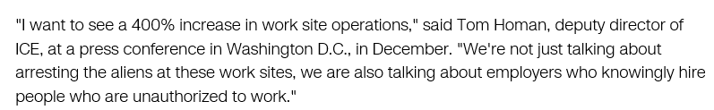
-CNN January 15, 2018

Slide 6
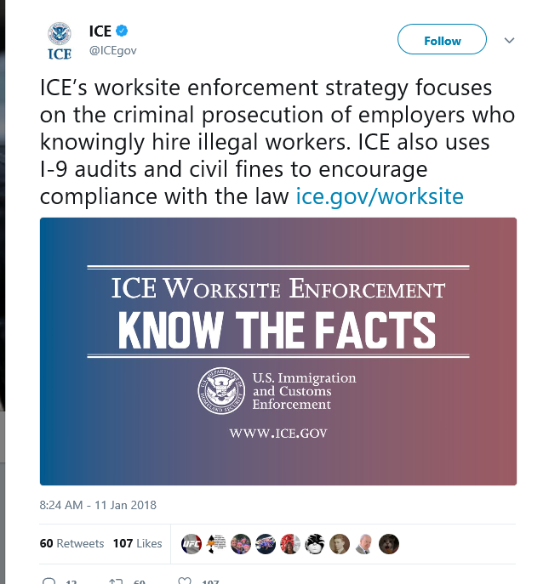

Slide 7
Enforcement Trends 2018
Source: https://www.hrdive.com/news/ice-worksite-investigations-are-already-double-that-of-last-year/523601
Enforcement action | 10/1/17-5/4/18 | 10/1/16-9/30/17
worksite investigations | 3,510 | 1,716
I-9 audits | 2,282 | 1,360
worksite-related arrests | 594 criminal 610 admin | 139 criminal 172 admin

Slide 8
Enforcement Trends 2018
The agency's worksite enforcement strategy continues to focus on the criminal prosecution of employers who knowingly break the law and the use of I-9 audits and civil fines to encourage compliance.
Source: https://www.hrdive.com/news/ice-worksite-investigations-are-already-double-that-of-last-year/523601

Slide 9
Overview of
I-9 employment verification process

Slide 10
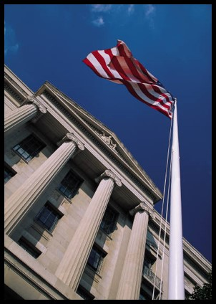
Immigration Reform & Control Act of 1986 (IRCA)
Prohibits unlawful hiring
Requires I-9 verification
Provides employer sanctions
Prohibits discrimination

Slide 11
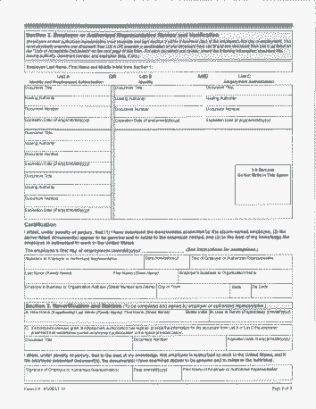
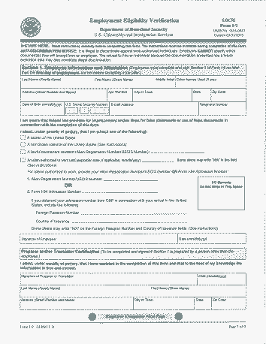
Form I-9
Use unexpired edition (“07/17/2017”)
http://www.uscis.gov/files/form/i-9.pdf
Notes:
Now we move to anatomy of the I-9 and steps for completion
Now a 2 page form – USCIS double sided copies
Access to instructions!!!
must complete Section 1 of the I-9 form on their first day of employment
Use form dated 2/2/09 or 8/7/09 but w/ expiration date of 8/31/12
( er can complete new I-9 for entire workforce using new rules or only use new form for new hires and reverifications)
3 page form
Sec 1 -
Sec 2 and
Sec 3

Slide 12

Employer Obligations
Review Section 1
Examine documents no later than 3 days after hire
Examine originals
Must appear genuine
Must relate to the employee
“good faith defense”
Avoid “document abuse”
Notes:
Is all of the requested information provided?
Is it signed?
Is it dated?
If revisions are made, the employee must initial and date the change
Er’s not doc police
But if doc’s do not appear genuine or to related, er has duty to inquire further
Avoid document abuse!

Slide 13
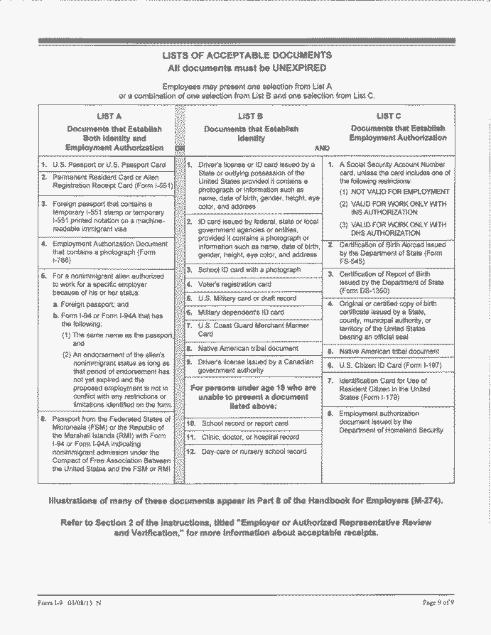
Acceptable Documents
By 3rd day of work, employee must provide:
1
List A
Identity
and
Work Authorization
1
List B
Identity
&
1
List C
Work
Authorization
OR

Slide 14

Reverifying I-9 Forms
Retaining I-9 Forms
Must reverify when work authorization expires; only applies if Sec. 1 shows temporary authorization
See handy tool at : https://www.uscis.gov/i-9-central/retain-store-form-i-9/retaining-form-i-9.
Completed I-9 Form must be retained for the later of:
  3 years from the date of hire
  or
  1 year from the date of termination

Slide 15

Don’t Leave Home Without It!
USCIS Handbook for Employers (M-274)
https://www.uscis.gov/sites/default/files/files/form/m-274.pdf

Slide 16
What’s New With
Form I-9?

Slide 17


What’s new?
Changed the name of the Office of Special Counsel for Immigration-Related Unfair Employment Practices to its new name, Immigrant and Employee Rights Section.

Slide 18
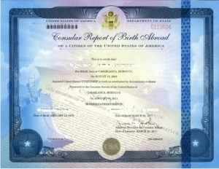
What’s new?
Added the Consular Report of Birth Abroad (Form FS-240) to List C.

Slide 19
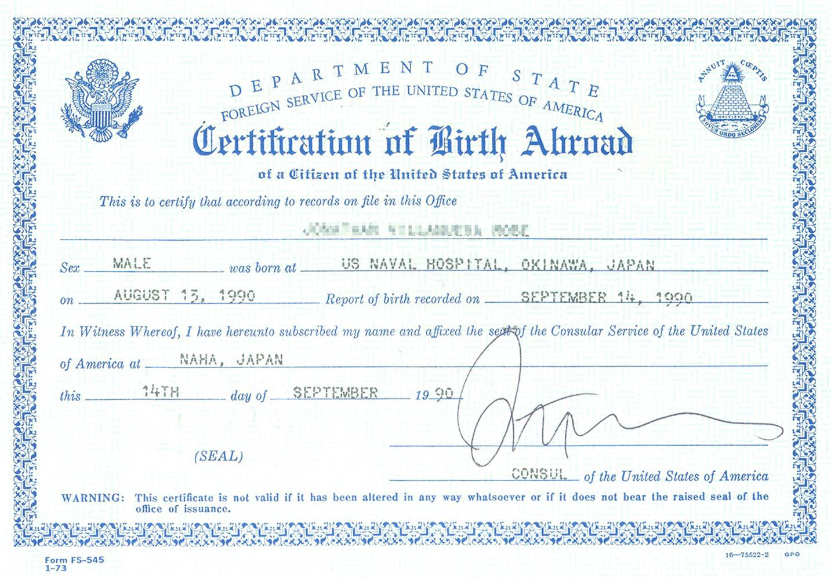
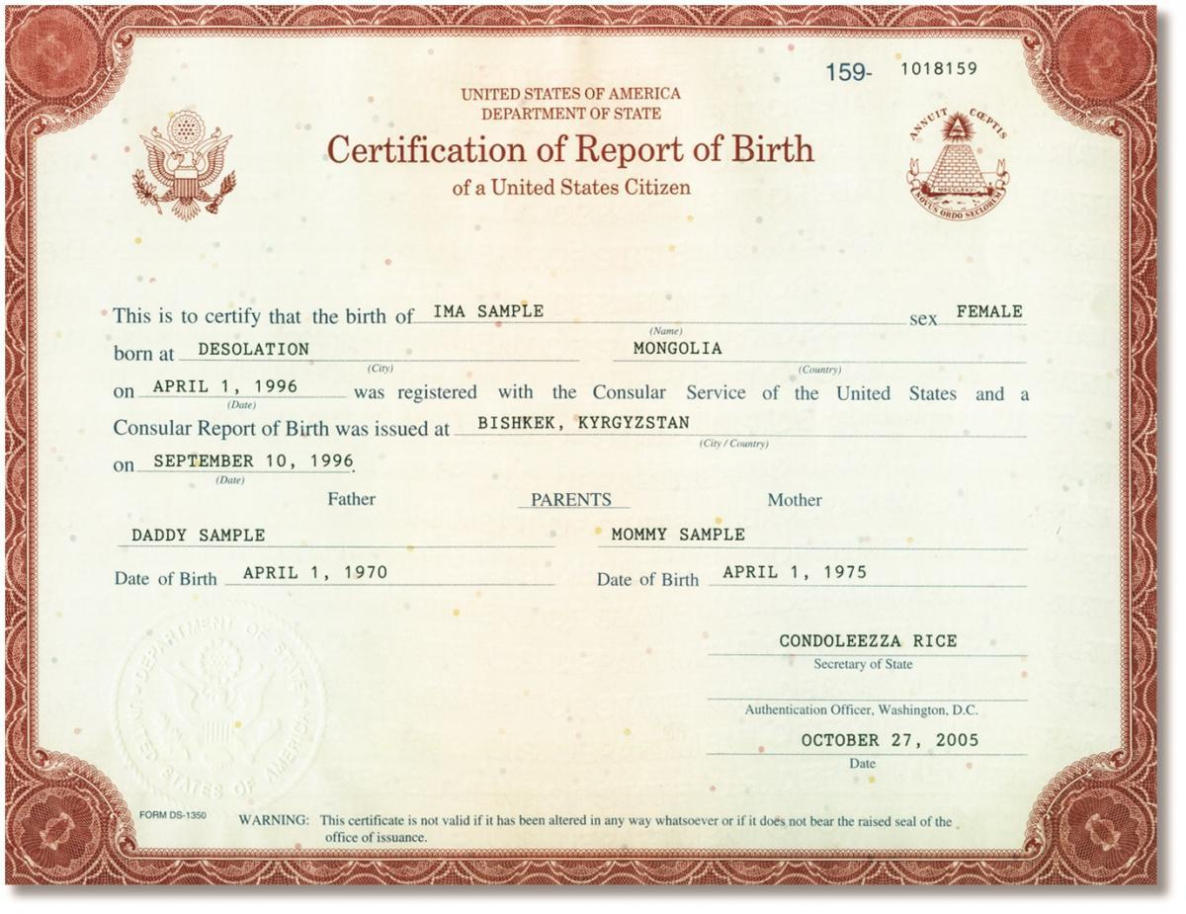
What’s new?
Combined all the certifications of report of birth issued by the Department of State (Form FS-545, Form DS-1350, and Form FS-240) into selection C #2 in List C.

Slide 20
What’s new?
Renumbered all List C documents except the Social Security card. For example, the employment authorization document issued by the Department of Homeland Security on List C changed from List C #8 to List C #7.

Slide 21
Tips to successfully complete I-9 forms and common mistakes

Slide 22
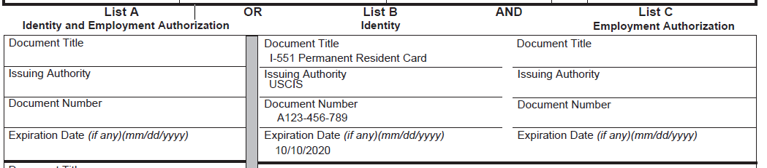
Common Mistakes:
What’s Wrong With This I-9?
Notes:
Transposition of List A, B and C Document Information
For example putting data about a Permanent Alien Resident Card (a/k/a Lawful Permanent Resident, LPR, PRC, green card), which is a List A document, in the spaces for List B or C documents.

Slide 23
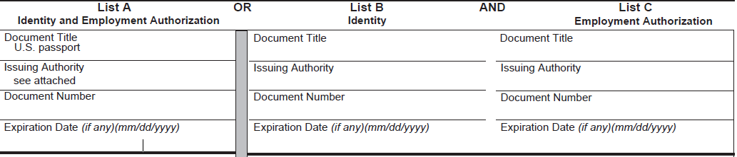
Common Mistakes:
What’s Wrong With This I-9?
Notes:
Section 2: Failure to Record Document Data/ Lack of Data
Must record the actual document information – cannot say “see attached.”
Must complete all required information about documentation of work authorization or identity.

Slide 24
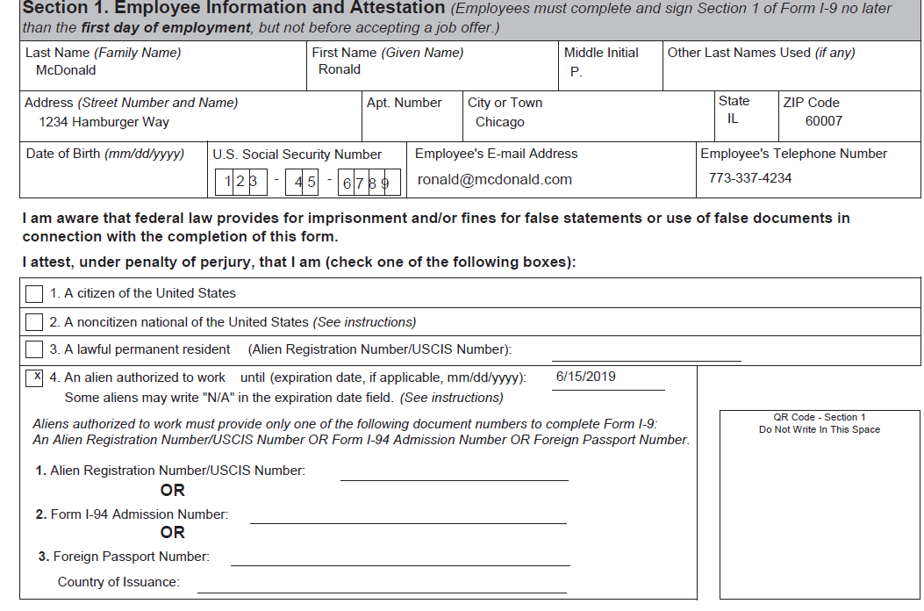
Common Mistakes:
What’s Wrong With This I-9?
Notes:
Section 1: Employee Information Incorrect or Missing
Employees must complete all fields including US immigration status, expiration of work authorization or “A” (USCIS Alien Number).
We have seen employees entering a birthday instead of the date in Section 1.

Slide 25
Common Mistakes:
Failure to Reverify / Untimely Completion of Verification or Reverification
Must complete initial verification no later than 3 days after hire.
Must reverify prior to expiration of work authorization.
We see failure to reverify often, for example, with individuals who have TPS.

Slide 26
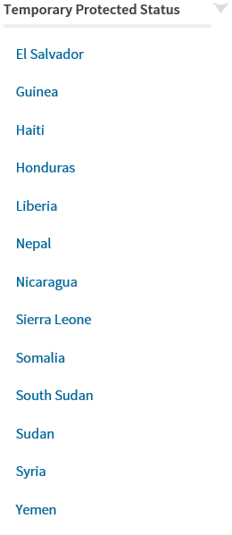
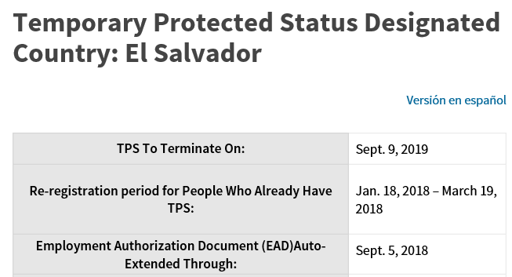
Special Case:
TPS (Temporary Protected Status)
Notes:
Automatic Employment Authorization Document (EAD) Extension
Sudan, Nicaragua, Haiti, El Salvador, Honduras and Nepal terminated
Sometimes DHS must issue a blanket automatic extension of the expiring EADs for TPS beneficiaries of a specific country in order to allow time for EADs with new validity dates to be issued. If the employee’s country’s EADs have been automatically extended, it will be indicated on the country specific pages to the left.
Source: https://www.uscis.gov/humanitarian/temporary-protected-status#Automatic%20Employment%20Authorization%20Document%20(EAD)%20Extension

Slide 27
Common Mistakes:
Document Authenticity Issues
Employer is not expected to be a document expert, but be on the lookout for obvious irregularities (computer generated signatures, large font, extended spacing between letters, etc.) and consult with counsel if you have questions.
Notes:
Multiple Social Security Cards (SSCs) with different numbers, documents for the same person containing different A numbers are red flags and may trigger a duty to investigate.
Employers may wish to implement a “dishonesty policy” allowing them to take action (including termination) against employees who initially present fraudulent documents and later become work authorized and present genuine documents.

Slide 28
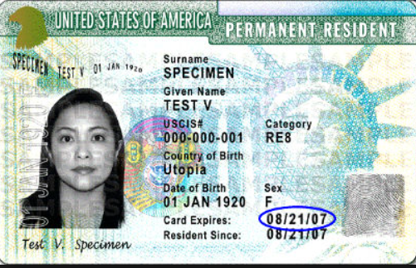
What’s Wrong With This Green Card?

Slide 29
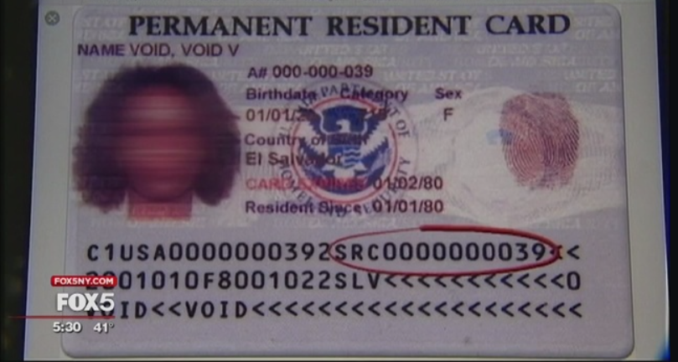
What’s Wrong With This Green Card?

Slide 30
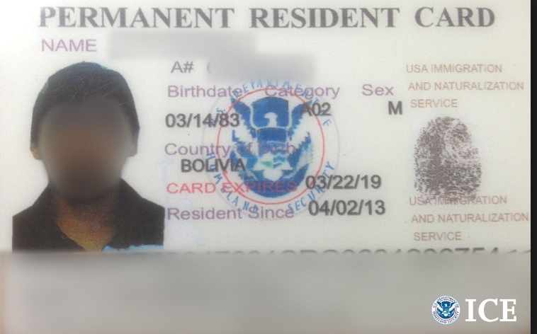
What’s Wrong With This Green Card?

Slide 31
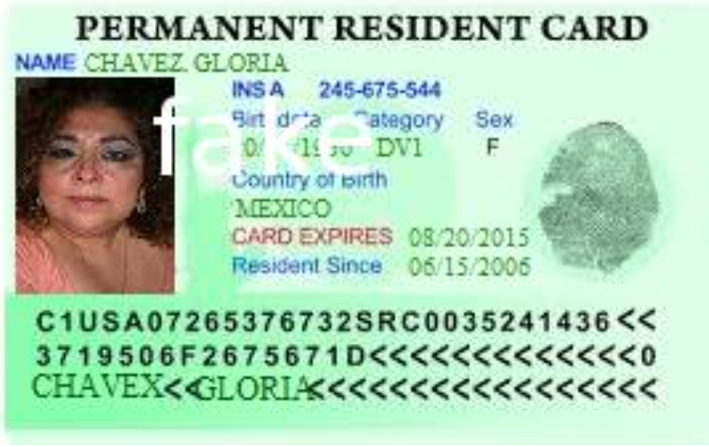
What’s Wrong With This Green Card?

Slide 32
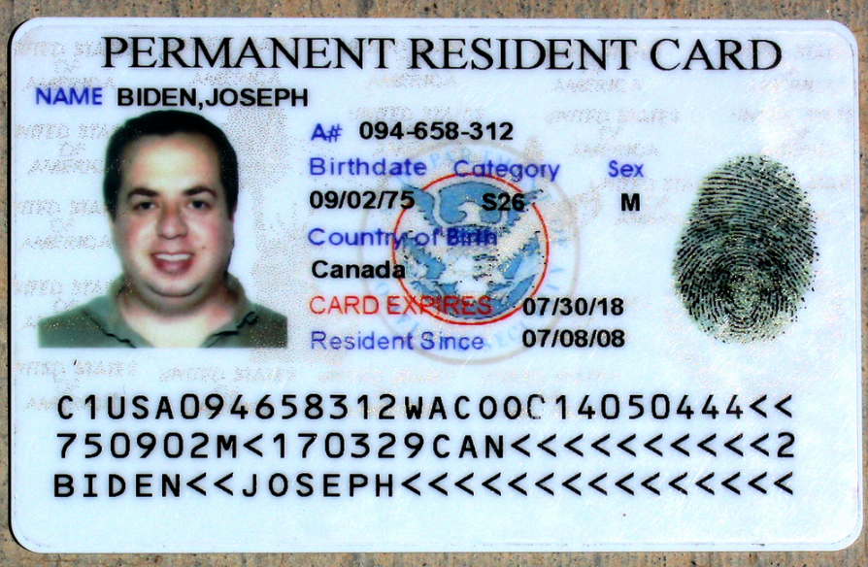
What’s Wrong With This Green Card?

Slide 33
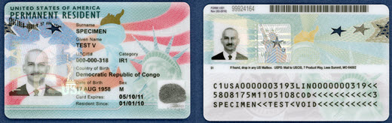
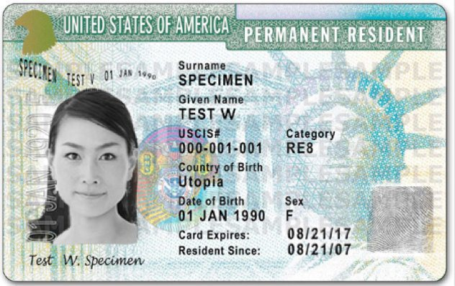
This is what a real green card looks like!

Slide 34
Common Mistakes
Overdocumentation (document abuse)
  Do not collect both a List A document (i.e. green card) AND a list C document (i.e. SSC).
  Do not reverify LPRs (including conditional LPRs) when their green cards expire. An LPR’s work authorization is incident to status and should not be reverified.
  Do not reverify List B identity documents.
  Requests for overdocumentation can be shared with the Justice Department, which enforces citizenship discrimination provisions.

Slide 35
From:
Top 10 Q&As for
Tough I-9 Issues
https://www.shrm.org/resourcesandtools/legal-and-compliance/employment-law/pages/tough-i-9-issues.aspx

Slide 36
Top 10 Q&As for Tough I-9 Issues
Q: I work at a summer camp, and a lot of our foreign national camp counselors come back each year. Do we need to complete a new I-9 for them?
A: If you rehire an employee within three years of the date that a previous Form I-9 was completed, you may either complete a new Form I-9 for your employee or complete Section 3 of the previously completed Form I-9, as long as the original I-9 shows current work authorization.

Slide 37
Top 10 Q&As for Tough I-9 Issues
Q: Must I reverify a female employee who changes her name upon getting married? What about a transgender employee who changes both name and gender?
A: You may, but are not required to, reverify an employee who has a name change. Since the form does not ask about gender, the same principle should apply to a transgender employee. One other interesting point about transgender employees: The "Other Names Used" field in the form has been changed to "Other Last Names Used" to avoid potential discrimination issues and provide increased privacy for transgender individuals and others who have changed their first names.

Slide 38
Top 10 Q&As for Tough I-9 Issues
Q: I'm completing an internal I-9 audit and my predecessor collected copies of too many documents (e.g., an employment authorization document (EAD) and a driver's license), but only recorded the required documents (e.g., the EAD). May I discard the extraneous documents?
A: This question resulted in a heated debate among my lawyer colleagues. Some took the position that the extraneous document(s) could simply be shredded because they arguably were not collected "in connection with" the I-9 process. A more conservative approach, with which I agree, suggests that, while the superfluous document(s) could be shredded, a memo should be made to the file to indicate that, while the document was collected in the course of completing the Form I-9, it was not used for the I-9 process and thus has been shredded.

Slide 39
Top 10 Q&As for Tough I-9 Issues
Q: Can I scan my I-9s and store them electronically?
A: Although there are rules advising how employers can store their own I-9s electronically, these rules are so complex that clients should not do this on their own. If you wish to store I-9s electronically, use a qualified vendor. (SHRM keeps a handy list.)

Slide 40
Top 10 Q&As for Tough I-9 Issues
Q: What should I do with my I-9s at the end of the required retention period?
A: Shred them. However, double-check the required retention periods and ensure that you maintain I-9s for all existing employees.

Slide 41
Top 10 Q&As for Tough I-9 Issues
Q: If an employee provides a driver's license and a restricted Social Security card, what should I do? The restricted Social Security card says "Valid for Work Only with DHS Authorization," so may I then ask for proof of DHS authorization?
A: This is a bit of a Catch-22 for the employer: Asking, directing or suggesting that the employee produce a specific document could be viewed as discrimination. Tell the employee that those two documents are not acceptable I-9 documents. You could then offer to go through the list of acceptable documents with the employee to discuss which documents or combination of documents are acceptable.

Slide 42
Top 10 Q&As for Tough I-9 Issues
Q: What is the earliest date I may complete the I-9?
A: Form I-9 may be completed as soon as you have offered the individual a job and he or she has accepted the offer.

Slide 43
Top 10 Q&As for Tough I-9 Issues
Q: May I accept an expired driver's license with a receipt for an extension?
A: No, though you may accept a receipt for a driver's license that was requested to replace a license that was lost, stolen or damaged.

Slide 44
Guidance on enforcement actions for employers

Slide 45

When can employers expect the government to come knocking on the door?
I-9 audits – comprehensive review of all employment eligibility verification documents. Usually conducted by National Homeland Security Investigations (HSI), part of ICE.
Site visits – targeted inspection of files relating to a particular sponsored employee. Usually conducted by Fraud Detection and National Security (FDNS), part of USCIS.
Raids – generally target employees with deportation orders. Usually conducted by National Fugitive Operations Program (NFOP), part of ICE.
Notes:
We will only cover I-9 audits in this session, but additional materials about site visits and raids are provided for those who are interested.

Slide 46
E-Verify

Slide 47
Administration Priority?
From USCIS Website:
On April 18, 2017, President Trump signed the Buy American and Hire American executive order to help reduce illegal immigration and preserve jobs for U.S. workers. To support these objectives, USCIS encourages all U.S. employers to verify all new hires through E-Verify.

Slide 48
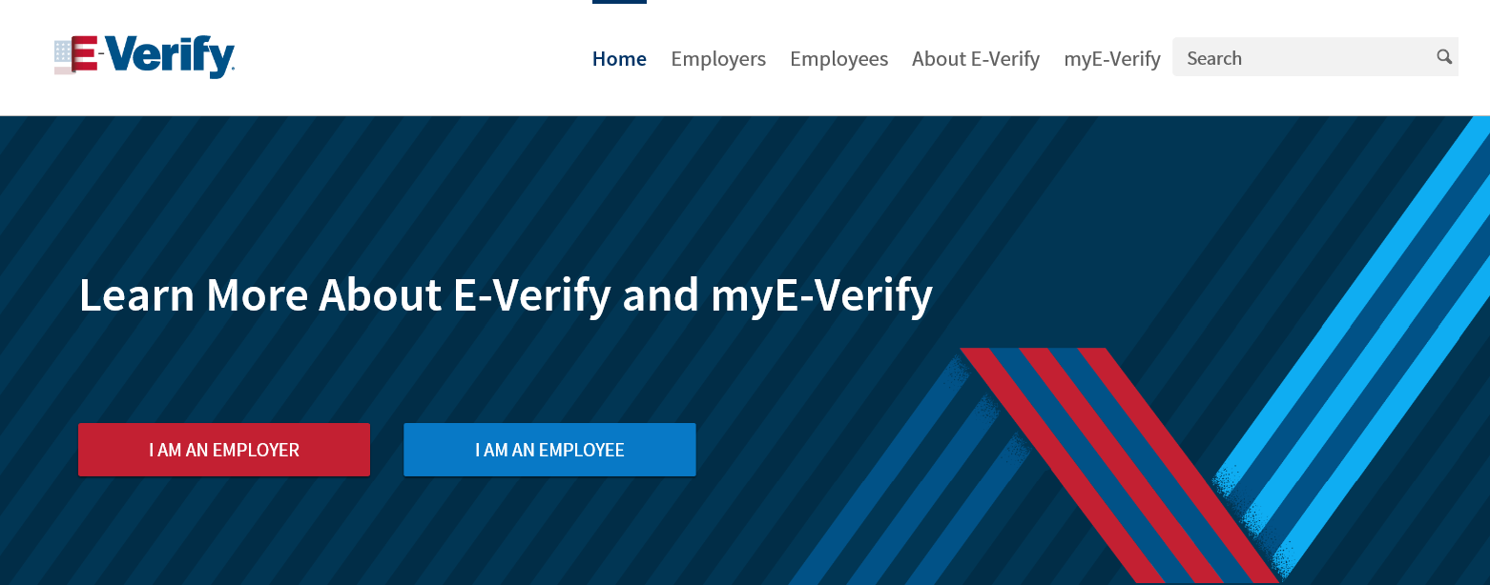
New E-Verify Website Launched in April 2018

Slide 49
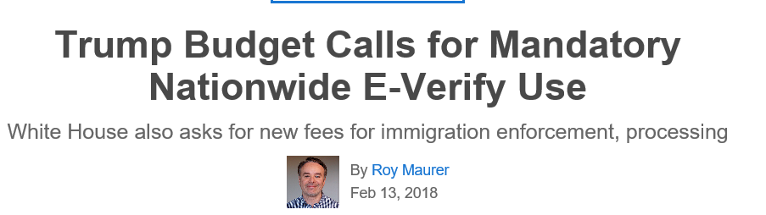
Source: https://www.shrm.org/resourcesandtools/hr-topics/talent-acquisition/pages/trump-budget-mandatory-nationwide-everify-use.aspx

Slide 50
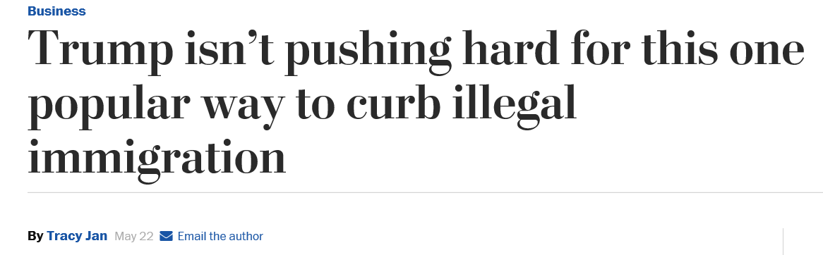
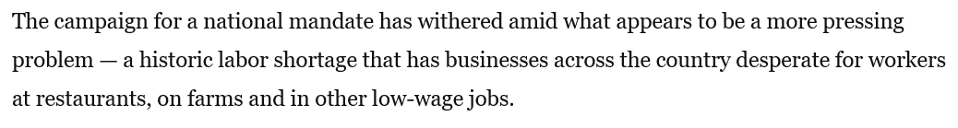
Or Not A Priority?
Source: https://www.washingtonpost.com/business/economy/trump-is-very-weak-on-this-one-popular-way-to-curb-illegal-immigration/2018/05/22/adf5f85e-399b-11e8-acd5-35eac230e514_story.html?utm_term=.26468474f6e6

Slide 51

Tension between I-9 verification and avoiding discrimination
Notes:
IRCA’s antidiscrim provisions try to prevent overzealous er's from excluding lawful workers who appear foreign.

Slide 52

Immigration Related Discrimination
Protected classes: US citizens, Legal Permanent Residents (except those who do not apply for naturalization within six months of eligibility), asylees and refugees.
Enforced by Immigrant and Employee Rights Section (IER) of DOJ (formerly Office of Special Counsel for Immigration-Related Unfair Employment Practices) or Equal Employment Opportunity Commission (EEOC)
  MOU between the agencies provides that they will refer to each other charges that allege violations under the laws each agency enforces.
Notes:
Unauthorized aliens not protected by IRCA i.e, alien who is not lawfully admitted for permanent residence or authorized to work.

Slide 53
Immigration Related Discrimination
Citizenship discrimination - employers may not limit job opportunities based on citizenship status, in the case of “protected individuals,” unless they have a legal basis to do so (only if required by federal law, or contract).
National origin discrimination – employers may not discriminate against any work-authorized individuals — not just “protected individuals” — based on national origin; for example, accent, country of nationality, ethnicity, cultural appearance, etc.

Slide 54
Immigration Related Discrimination
Document abuse (examples)
  Demanding a specific document to complete I-9.
  Asking for additional documents even though employee has already provided sufficient documents.
  Re-verifying a permanent resident.
  Refusing to accept a worker’s expired EAD, even when she shows the employer an official press release from USCIS stating that all such EAD’s have been automatically extended until the following year.
  Reverifying (or requesting specific documents from, or retaining copies of documents from) only workers of a specific ethnicity.

Slide 55
Immigration Related Discrimination
Retaliation - employer must not retaliate against a person who:
  Files a charge of discrimination with the federal government.
  Participates in an investigation or prosecution of a discrimination complaint.
  Asserts his or her rights or the rights of another person under anti-discrimination laws.

Slide 56

Appendix A:
I-9 Audits

Slide 57

What happens in an I-9 Inspection (Audit)?
ICE serves (in person, or by certified mail) a Notice of Inspection (NOI) upon an employer compelling the production of Forms I-9.
Employers are provided with at least three business days to produce the Forms I-9.
Often, ICE will ask for supporting documentation, which may include a copy of the payroll, list of current employees, Articles of Incorporation, tax statements, and/ or business licenses.

Slide 58
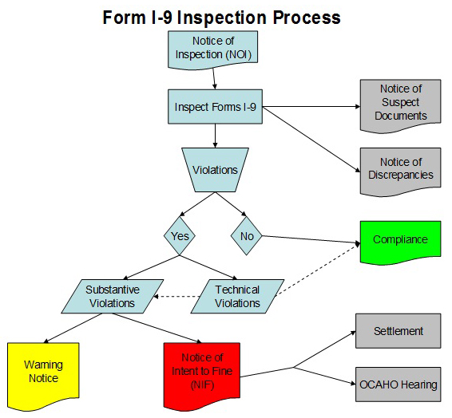
I-9 Inspections
Notes:
How does ICE select er for inspection? answer far from clear. In general, usu based on ”credible leads, e.g. complaints from disgruntled employees, tips from the public or cases having national security or public safety implications (e.g., employers at airports). Or based on referrals from other government agencies, e.g. WH div of DOL. Industries w/high turn-over & frequent reports of undocumented workers, e.g., construction, hospitality, retail & other industries.
In summer 2015, three of our clients in the construction industry were audited. As we go through the next slides on the I9 audit process, I’ll share some real-life examples and anecdotes from those three audits.

Slide 59
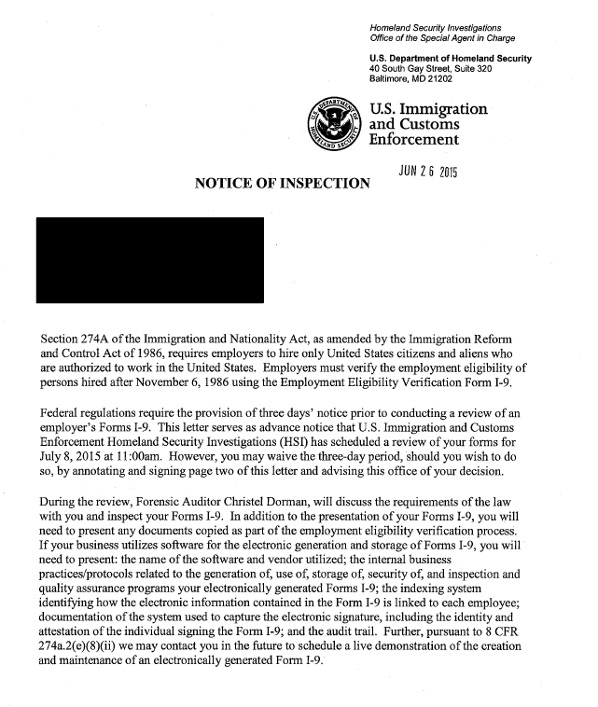
Notice of Inspection (NOI)

Slide 60
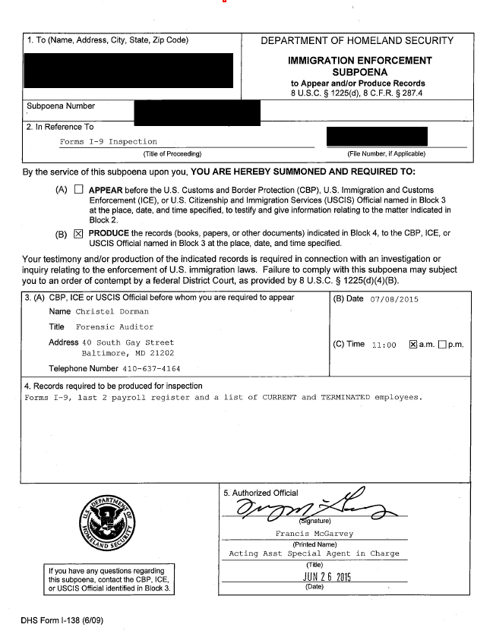
Subpoena
Notes:
In this case NOI was served 7/2 (thurs), had to produce docs by 7/8 (following wed) – notice this falls over a holiday weekend! Can ask for extension.

Slide 61
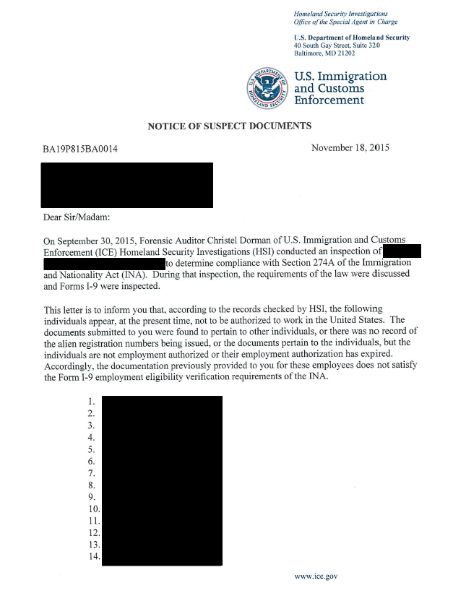
Notice of suspect documents
ICE has determined that at least one employee is unauthorized to work and advises the employer of the possible criminal and civil penalties for continuing to employ that individual.
Notes:
After you turn your I-9s and other documents over to ICE, you then wait for a period of weeks or months, after which you can expect to receive one or more of three possible notices. In this case took 133 days (about 4.5 months) for ICE to issue NSD.

Slide 62
Other possible notices
Notice of Discrepancies –based on a review of the Forms I-9 and documentation submitted by the employee(s), ICE has been unable to determine their work eligibility.
Notice of Technical or Procedural Failures – identifies technical violations identified during the inspection and gives the employer ten business days to correct the forms.

Slide 63
Next steps
After Receiving Notice Of Suspect Documents
Notes:
In this case, employer had about 250 employees; 138 (more than half of the workforce) were listed on NSD. We were given until 12/3, or 10 business days, to reply (note this falls over Thanksgiving holiday). Result was negotiated termination schedule (next slide).

Slide 64
Sample negotiated termination schedule
Group One: by January 1, 2016
Group Two: by February 1, 2016
Group Three: by March 1, 2016
Group Four: by April 1, 2016

Slide 65
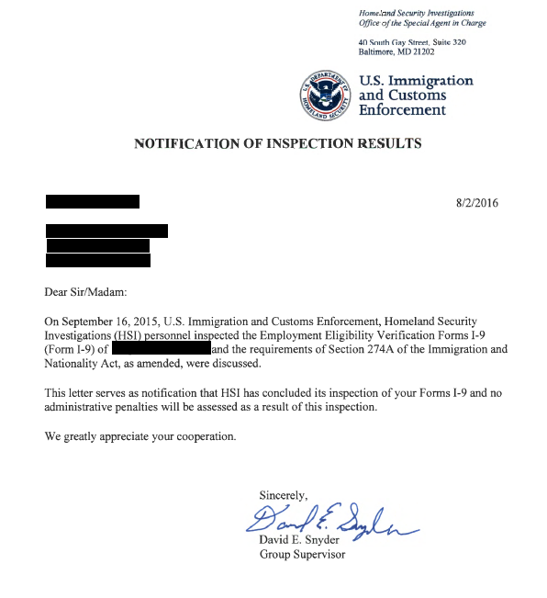
Notice of Inspection Results
Also known as a "compliance letter," used to notify a business that they were found to be in compliance
Notes:
Took about one year from NOI to compliance letter

Slide 66
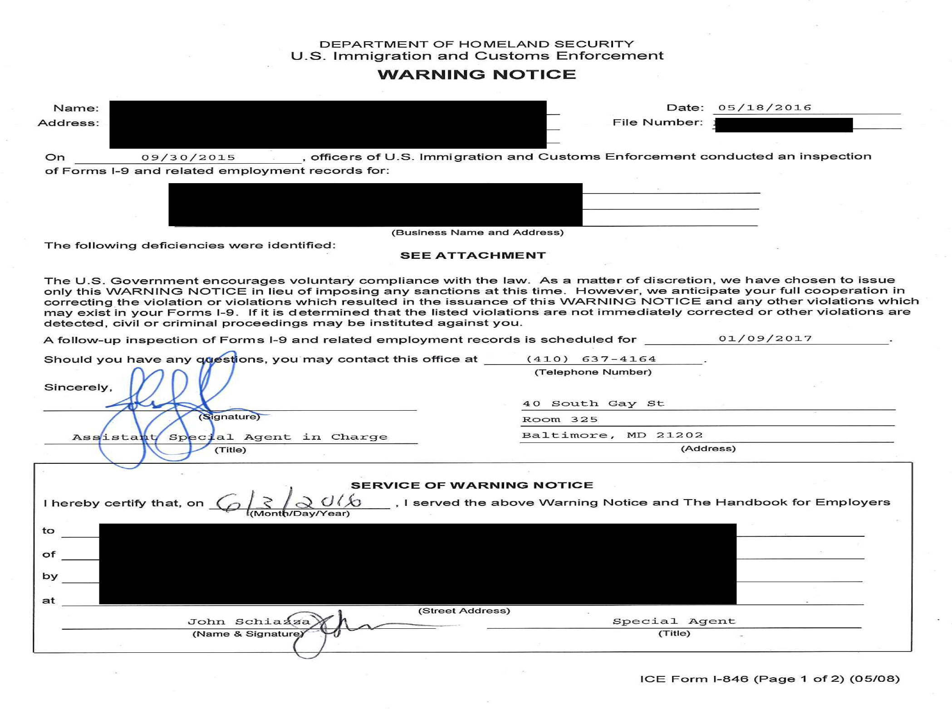
Warning Notice
Despite substantive verification violations, circumstances do not warrant a monetary penalty, and there is expectation of future compliance.
Notes:
Took about one year from NOI to warning notice.
In another case we received NOI 7/2015, NSD 8/2016, terminated in 3 groups ending 12/30/16 – no final notice yet.

Slide 67
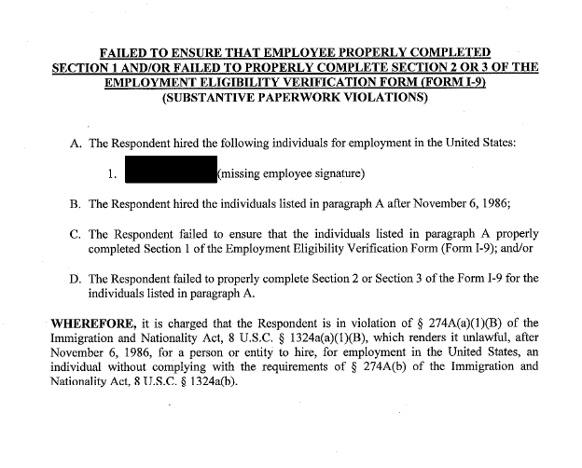
Attachment to warning notice

Slide 68
Notice of Intent to Fine (NIF)
May be issued for substantive, uncorrected technical, knowingly hire and continuing to employ violations.
Govt issues charging documents. Possible outcomes:
  Negotiated settlement
  Hearing before Office of the Chief Administrative Hearing Officer (OCAHO)
  Final Order (if no action from employer)

Slide 69
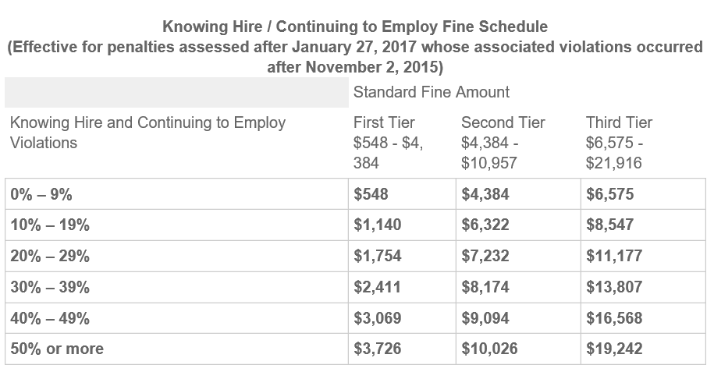
Penalties for Knowingly Hire / Continuing to Employ Violations
Source: http://www.ice.gov/factsheets/i9-inspection
Notes:
The agent or auditor will divide the number of knowing hire and continuing to employ violations by the number of employees for which a Form I-9 should have been prepared to obtain a violation percentage. This percentage provides a base fine amount depending on whether this is a First Tier (1st time violator), Second Tier (2nd time violator), or Third Tier (3rd or subsequent time violator) case. The standard fine amount listed in the table relates to each knowing hire and continuing to employ violation.

Slide 70
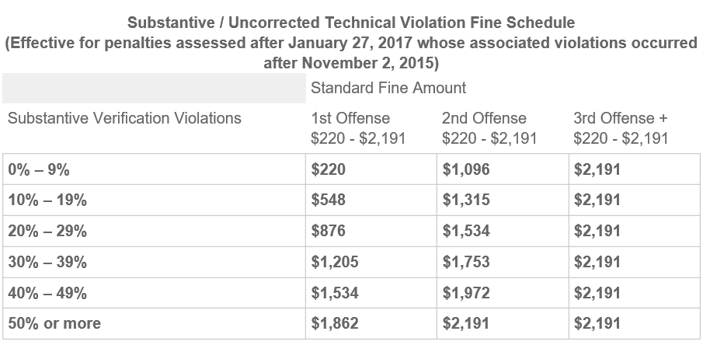
Penalties for Substantive/ Uncorrected Technical Violations (“paperwork violations”)
Notes:
The agent or auditor will divide the number of violations by the number of employees for which a Form I-9 should have been prepared to obtain a violation percentage. This percentage provides a base fine amount depending on whether this is a first offense, second offense, or a third or more offense. The standard fine amount listed in the table relates to each Form I-9 with violations.
Penalties increased substantially August 1, 2016
Also an “enhancement matrix” (business size, good faith) etc. could increase or decrease penalties by up to 25%
possible criminal penalties, and debarment from government contracts

Slide 71
Appendix B:
E-Verify

Slide 72


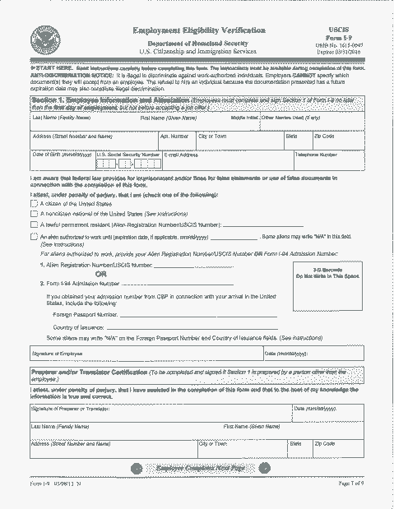




Slide 73
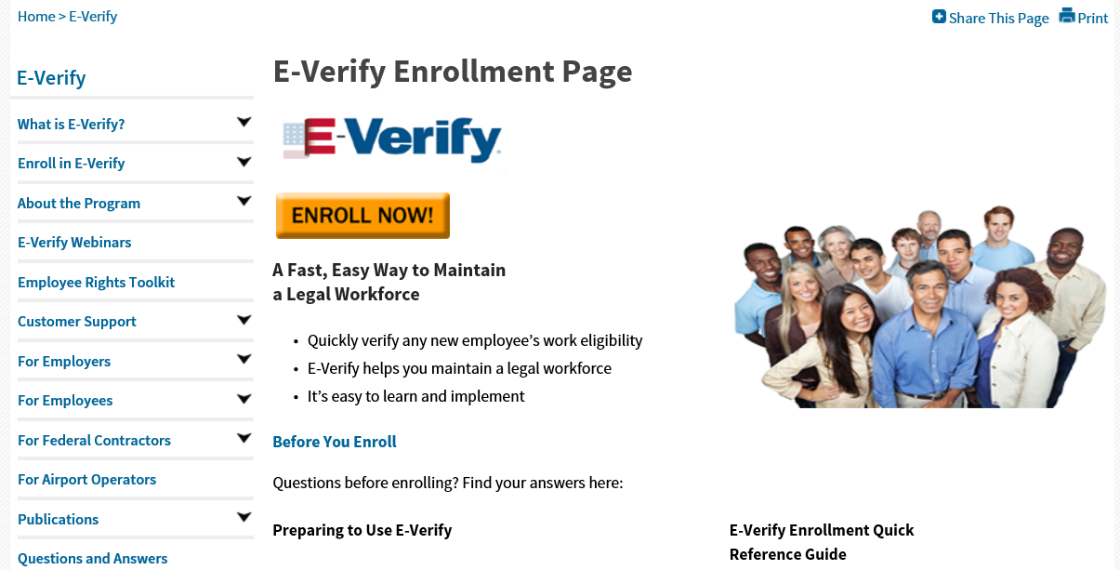
Online resources
https://www.uscis.gov/e-verify
https://www.uscis.gov/e-verify/e-verify-enrollment-page
https://www.uscis.gov/e-verify/customer-support/contact-e-verify

Slide 74
To e-verify or not to e-verify?
Mandatory for some employers (federal contractors and employers in certain states)
Mandatory for employers who sponsor STEM extension
Trump included funding to support nationwide E-Verify mandate in 2018 budget request
PROS
Peace of mind
ICE “best practice” and creates rebuttable presumption that employer did not hire unauthorized worker
Elimination of SSA no match letters
CONS
Increased government scrutiny
Additional expenses for training and data entry
Potential discrimination claims if data entered early

Slide 75
E-verify overview
Compares information from Form I-9 to Department of Homeland Security (DHS), Social Security Administration (SSA), and Department of State (DOS) records to confirm that an individual is authorized to work in the United States.
Two possible results:
  Employment Authorized: The information entered by the employer matches with government records
  Or . . .

Slide 76
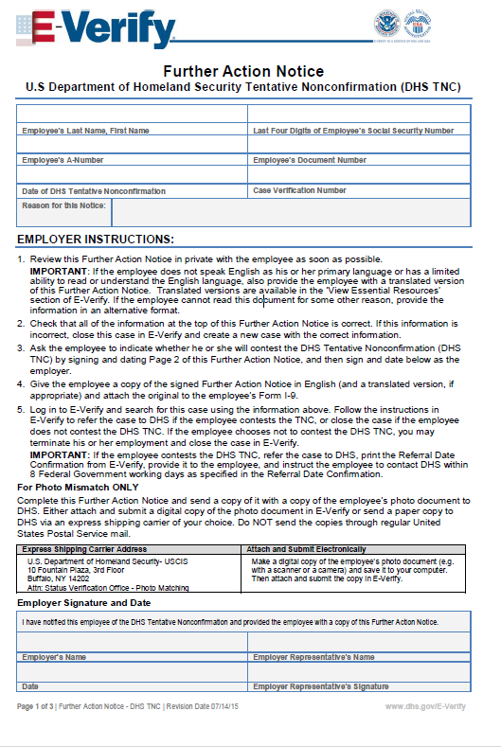
Tentative Non-confirmation (TNC): The information entered by the employer does not match with government records.
E-Verify system will generate a Further Action Notice for employer to review with employee. If employee wishes to contest the TNC and correct the records, s/he must so indicate on the Further Action Notice.

Slide 77
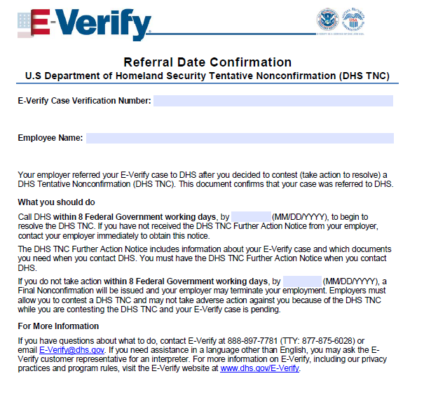
The employer must go back into the E-Verify system and generate a Referral Date Confirmation (employee’s deadline for contacting responsible government agency).
If employee decides not to contest, or employer receives a Final Non-confirmation result indicating the employee’s work authorization cannot be confirmed, then employer must terminate.
Notes:
Ee must contact SSA/DHS within 8 govt working days; if he does not, EV will return FNC w/in 10 days
EV will show “case in continuance” if SSA or DHS needs more than 10 USG work days to resolve

Slide 78
Appendix C:
Employer compliance best practices

Slide 79
Mutual Agreement between Government and Employers (IMAGE) is a voluntary program operated by ICE that “assists employers in targeted sectors develop a more secure and stable workforce… [and] enhances fraudulent document awareness through education and training.”
IMAGE’s Best Practices (https://www.ice.gov/image) contain many principles that should be incorporated in a sound I-9 Compliance policy.

Slide 80
IMAGE Best Practices
Use E-Verify to verify the employment eligibility of all new hires.
Use the Social Security Number Verification Service (SSNVS) for wage reporting purposes.
Establish a written hiring and employment eligibility verification policy.

Slide 81
IMAGE Best Practices
Establish an internal compliance and training program related to the hiring and employment verification process.
Require the Form I-9 and E-Verify process to be conducted only by individuals who have received appropriate training and require a secondary review.
Arrange for annual Form I-9 audits by an external auditing firm or a trained employee not otherwise involved in the Form I-9 process.

Slide 82
IMAGE Best Practices
Establish a procedure to report to ICE credible information of suspected criminal misconduct in the employment eligibility verification process.
Ensure that contractors and/or subcontractors establish compliance procedures and policies.
Establish a protocol for responding to
“no match” letters and other similar government communications.

Slide 83
IMAGE Best Practices
Establish a tip line mechanism for employees to report activity relating to the employment of unauthorized workers, and a protocol for responding to credible employee tips.
Establish and maintain appropriate policies, practices and safeguards to avoid discrimination based on citizenship status or national origin.
Maintain copies of any documents accepted as proof of identity and/or employment authorization in connection with the I-9 process for all new hires.

Slide 84

Contact Information:
8737 Colesville Road, Suite 500
Silver Spring, MD 20910
Tel: + 1 301 917 6900
Fax: + 1 301 424 0929
byoung@hyimmigration.com
www.hyimmigration.com

Slide 85
Thank You!

