Slide 1
IMMIGRATION UPDATE
PRESENTED BY:
BECKI L. YOUNG, ESQ., HAMMOND YOUNG IMMIGRATION LAW, LLC SANDRA GROSSMAN, ESQ., GROSSMAN LAW, LLC
Covington & Burling, LLP May 16, 2018

Slide 2
Becki Young
Becki L. Young, co-founder of Hammond Young Immigration Law and head of the firm's Hospitality Practice, is a seasoned business immigration attorney with 20 years of experience in the field. She has represented more than 100 of the world's most prominent hotels and restaurants, and facilitated the sponsorship of foreign professionals, trainees, interns and individuals of "extraordinary ability." In addition to her hospitality practice, Ms. Young regularly provides immigration law advice to clients in a broad range of industries. Ms. Young is an active member of the American Immigration Lawyers Association (AILA). She frequently speaks at legal, business and hospitality conferences, and regularly contributes insight through published articles and commentary. She is highly recommended (Band 3) by Chambers & Partners and recognized as a Leading Legal Practitioner in Corporate Immigration by Who's Who Legal. Hammond Young Immigration Law LLC is rated Tier 1 National and Washington DC for Immigration Law by US News & World Report / Best Lawyers.

Slide 3
Sandra Grossman
Sandra Grossman is the Managing Partner of Grossman Law, LLC, a full-service, immigration law firm operating in Bethesda, Maryland. She is an experienced litigator, having successfully represented individuals in many aspects of immigration law before the immigration courts, Board of Immigration Appeals, and the Federal District Courts. Ms. Grossman represents clients in the area of deportation defense, detention and bond issues, the immigration consequences of criminal convictions, consular processing, requests under the Freedom of Information Act (FOIA), waivers of inadmissibility, asylum, adjustment of status and naturalization applications, and extraordinary ability and artist’s visas, among many other matters.
She is a Former Adjunct Associate Professor in Immigration Law at the Washington College of Law, American University. Ms. Grossman publishes and speaks frequently on the topic of immigration law and is a member of the Editorial Board of Bender’s Immigration Bulletin as well as a regular contributor to the Huffington Post. Ms. Grossman is a Member of the American Immigration Lawyers Association (AILA). She was Vice Chair of AILA’s Asylum and Refugee Committee (2016-2017).
She is a native Spanish and English speaker and is conversant in French.

Slide 4
Enforcement,
Border Security, and “The Wall”
Notes:
Going to first provide some statistics… We will see that the goal of the

Slide 5
Increased Enforcement:
Everyone is a Priority
 | Total ICE Arrests | Total Interior Removals | Non-Criminal Interior Removals
FY 2015 | 119,772 | 69,478 | 5,939
FY 2016 | 110,104 | 65,332 | 5,014
FY 2017 | 143,470 | 81,603 | 13,744
Source: ICE, Fiscal Year 2017 ICE Enforcement and Removal Operations Report https://www.ice.gov/removal-statistics/2017
Notes:
Arrests: An administrative arrest is the arrest of an alien for a civil violation of the immigration laws, which is subsequently adjudicated by an immigration judge or through other administrative processes. (This does not include border apprehensions made by CBP. This only includes arrests made by ICE ERO)
FY2017, ICE ERO recorded 143,000 arrests → its greatest number of administrative arrests as compared with the past three fiscal years.
There were 33,366 more administrative arrests in FY2017 than in FY2016 = 30% increase
The removal of immigrants with no criminal background nearly tripled from FY 2016 to FY 2017 (2.75 times more non-criminal immigrants removed in 2017 than 2016)
President Donald Trump signed three executive orders on immigration during his first week in office.
The orders focused on border security, interior enforcement, and “extreme vetting” and temporary entry bans for refugees and nationals from certain Muslim-majority countries.
On February 20, the Department of Homeland Security (DHS) released supplemental memos with further guidance on implementing the orders. The provisions of the order and memo on interior enforcement represent a stark shift in policy and have had an immediate impact on our removal system.
The Obama administration created a list of detailed enforcement priorities with a strict hierarchy (persons convicted of a felony or who were deemed a threat to national security as priority one. Persons convicted of three or more misdemeanors, significant misdemeanors as priority two, and persons with recent removal orders as priority three) .
By policy, unauthorized immigrants who did not fall within the narrow priorities were essentially protected from any enforcement.
On the other hand, while Trump’s removal policy seems geared to focus on “criminal” aliens, it also vaguely references broad sections of immigration law and categories of non-citizens that essentially make all unauthorized immigrants “priorities” for removal at any time.
Unlike the priorities put in place in 2014, there is no inherent hierarchy in the list of priorities listed in Trump’s order—all are listed as equally important for removal.
Additionally, “criminal offenses” is not defined (felonies vs misdemeanors, etc.), and could include minor misdemeanors like traffic offenses or crimes related to immigration status like illegal entry or reentry, that were specifically deprioritized by the Obama policy.
The order also moves away from a focus on convictions to people “charged” or believed to have “committed acts that constitute a chargeable” offense—broad categories that presume guilt not proven in court. Combined with the extension of so-called 287(g) agreements that would deputize state and local law enforcement as immigration agents,
these changes have also raised concerns among advocates that some jurisdictions will make individuals priorities for deportation by first arresting and charging them with a crime, regardless of the merits of the case.
This has all translated to a massive increase in administrative arrests →

Slide 6
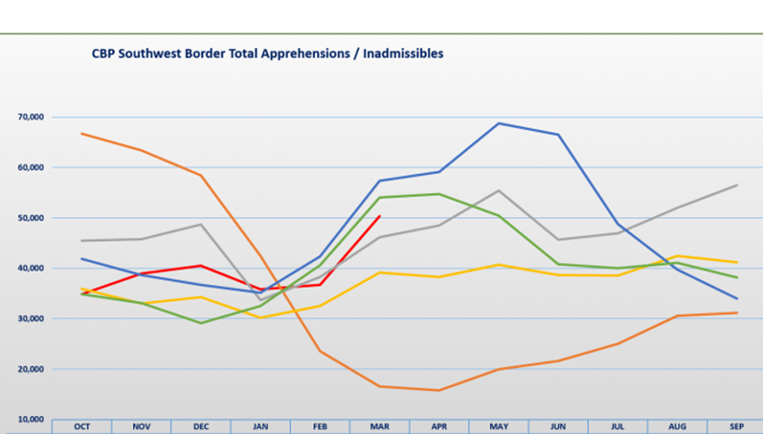
Border Enforcement: End of “Catch and Release” and “Zero Tolerance”
•Border Patrol: more than 20,000 agents along the border
•National Guard troop deployment: 2,000-4,000 members
Source: CBP, Southwest Border Migration FY2018 https://www.cbp.gov/newsroom/stats/sw-border-migration
Notes:
Arrests tend to follow a pattern. The numbers begin to rise late in winter, peak in the spring and dip in the summer as the Southwest heat becomes insufferable
Orange Line: That pattern broke after Trump’s election. Arrests dipped after the election and plunged after Trump took office. April 2017 logged the fewest arrests in a single month since the Homeland Security Department was created in 2003. Indeed, thanks to that drop, the 2017 budget year logged the fewest Border Patrol arrests in 45 years.
But after April 2017, the numbers ticked up. In the autumn they returned to rates seen during Obama’s second term.
Red Line: New federal statistics show 50,308 arrests in March 2018 — a 203 % increase from March 2017, when there were only 16,588 arrests, and 37% more than the previous month.
Trump called the numbers a “point of crisis” in his proclamation seeking National Guard deployment to the Southern border → Defense Secretary James Mattis has authorized the deployment of up to 4,000 troops on the U.S. border with Mexico. The National Guard troops will not be able to perform law enforcement activities while they are stationed on the border. According to a Pentagon memo, they will also be armed under limited circumstances, mainly self-defense.
Reports from the areas, however, show that the scope of National Guard’s activities is primarily limited to observing and reporting activity along the border.
http://time.com/5238395/national-guard-troops-mexico-border/
Memorandum Ending Catch and Release (04/06/2018):
Trump signed a memorandum on April 6, 2018 ordering the end of the policy known as “catch and release,” in which illegal immigrants are released from detention while awaiting a court hearing on their status
Calls on DHS, DOS, and other relevant agencies to report to the President on actions being taken towards the following: •Allocate available resources to construct/operate detention facilities near the border •Assign asylum officers to detention facilities to accept asylum referrals and conduct fear interviews •Ensure the detention of aliens apprehended for violations of immigration law •Ensure that the parole and asylum provisions of Federal immigration Presidential Documents law are not illegally exploited to prevent the removal of otherwise removable aliens; •Ensure the assessment and collection of all authorized fines and penalties from aliens unlawfully present in the United States and from those who facilitate their unlawful presence •A detailed list of all existing facilities, including military facilities, that could be used, modified, or repurposed to detain aliens for violations of immigration law at or near the borders of the United States; •The number of credible fear and reasonable fear claims received, granted, and denied—broken down by the purported protected ground upon which a credible fear or reasonable fear claim was made—in each year since the beginning of fiscal year 2
Huge negative impact on Due Process/Opportunity to Present a Free and Fair Trial - Cite Artesia Example.
DOJ Response = “Zero Tolerance Policy” announced 5/7/18
On April 6, the AG notified all U.S. Attorneys offices on the southwest border of a new ZERO TOLERANCE POLICY for offenses under 8 U.S. Code § 1325 - which prohibits both attempted illegal entry and illegal entry into the u.s. by an alien. DOJ issues a statement noting that the policy was due to a 203% increase in illegal border crossings from march 2017 to March 2018
8 U.S. Code § 1325 - Improper entry by alien First-time offenders usually face a federal misdemeanor punishable by up to six months in prison or fines. Repeat offenders can be imprisoned for up to two years and fined, or charged with the more serious offense of “illegal reentry.”
The “zero-tolerance” measure announced could split up thousands of families because children are not allowed in criminal jails. Until now, most families apprehended crossing the border illegally have been released to await civil deportation hearings.
Sessions: to carry out the new enforcement policies, he was sending 35 prosecutors to the Southwest and 18 immigration judges to the border to handle asylum claims
8 U.S. Code § 1325 - Improper entry by alien
(a)Improper time or place; avoidance of examination or inspection; misrepresentation and concealment of facts
Any alien who (1) enters or attempts to enter the United States at any time or place other than as designated by immigration officers, or (2) eludes examination or inspection by immigration officers, or (3) attempts to enter or obtains entry to the United States by a willfully false or misleading representation or the willful concealment of a material fact, shall, for the first commission of any such offense, be fined under title 18 or imprisoned not more than 6 months, or both, and, for a subsequent commission of any such offense, be fined under title 18, or imprisoned not more than 2 years, or both.
(b)Improper time or place; civil penalties Any alien who is apprehended while entering (or attempting to enter) the United States At a time or place other than as designated by immigration officers shall be subject to a civil penalty of—
(1)
at least $50 and not more than $250 for each such entry (or attempted entry); or
(2)
twice the amount specified in paragraph (1) in the case of an alien who has been previously subject to a civil penalty under this subsection.
Civil penalties under this subsection are in addition to, and not in lieu of, any criminal or other civil penalties that may be imposed.
(c)Marriage fraud
If s/he have previously been ordered deported and then re-entered the U.S., or if s/he were ordered deported and never left, DHS will attempt to reinstate the prior deportation order and order him/her removed. Because of this situation, the standard is higher and you will have a "reasonable fear" interview. Whereas with "Credible fear," the standard is "significant possibility," with a "reasonable fear" interview, the standard is whether there is a "reasonable possibility" s/he will be persecuted or tortured in your home country. If s/he passes the interview, s/he can apply for withholding of removal and/or the Convention Against Torture (CAT) in front of an immigration jud

Slide 7
The Wall: Where are We?
Notes:
Separate fact from fiction - you may have seen such images circulating in the media about wall construction on the Southern border. However, the reality of the ‘Wall’ as well as other border security measures sought after by the Trump administration, is much different.
We have a 2,000 mile border with Mexico
Right now a mix of barriers, like chain link fences, steel walling and beams, covers about 650 miles of the border.
This year the administration asked for $1.6 billion to build a border wall in the Rio Grande Valley in South TExas. Congress rejected that request in the 2018 Omnibus Spending Package
But congress provided nearly 1.6 billion for border security - including new technology and repairs for existing borders.
Administration characterizes this as a “down payment for the wall”
The new spending plan allocated $641 million for about 33 miles of new fencing
Mr. Trump has expressed frustration at the inability to build the border wall and has spoken with Defense Secretary Jim Mattis about having the military pay for it. Shifting budget funds from the Defense Department would require congressional approval, which some lawmakers say is unlikely.
Source: Washington Office on Latin America (WOLA) Report: Lessons from San Diego’s Border Wall https://www.wola.org/analysis/wola-report-lessons-san-diegos-border-wall/
Why the Wall is Ineffective:
Fences or walls can reduce migration in urban areas, but make no difference in rural areas. In densely populated border areas, border-crossers can quickly mix in to the population. But nearly all densely populated sections of the U.S.-Mexico border have long since been walled off. In rural areas, where crossers must travel miles of terrain, having to climb a wall first is not much of a deterrent. A wall would be a waste of scarce budget resources.
People who seek protected status aren’t deterred by walls.
Two-thirds of those who joined the undocumented population did so by entering with a valid visa and then overstaying their period of admission (CMS)
Overstays have exceeded those entering illegally every year since 2007, and there have been half a million more overstays than illegal entries since 2007.
Fences are irrelevant to drug flows.
Of all nine border sectors, San Diego leads in seizures of heroin, methamphetamine, cocaine, and probably fentanyl. Authorities find the vast majority of these drugs at legal border crossings—not in the spaces between where walls would be built. Interdicting more drugs at the border would require generous investment in modern, well-staffed ports of entry—but instead, the Trump administration is asking Congress to pay for a wall.
Border Security Alternatives
The border doesn’t need a wall. It needs better-equipped ports of entry, investigative capacity, technology, and far more ability to deal with humanitarian flows.
Smart, localized adjustments would actually be far less expensive (and more effective) than building the Wall

Slide 8
Immigration Courts
Notes:
58 IMMIGRATION COURTS
Executive office of immigration review - part of DOJ
EOIR Mission: to adjudicate immigration cases by fairly, expeditiously, and uniformly administering and interpreting federal immigration laws
unfortunately, data indicates that the courts fall short on all three
Two administrative courts in the area

Slide 9
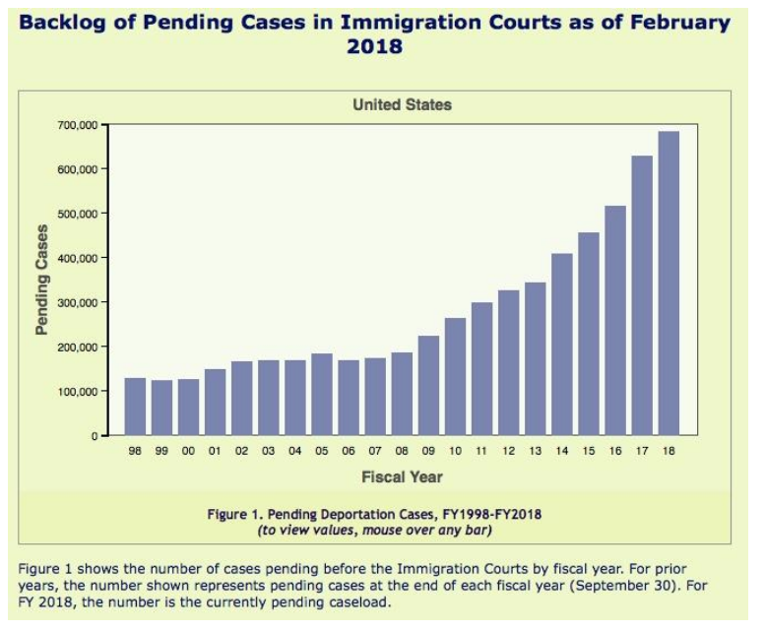
Backlog: 687,000 Cases
Notes:
Sources:
U.S. Government Accountability Office (GAO) report
The Hill http://thehill.com/opinion/immigration/381616-immigration-judge-quotas-will-not-eliminate-the-backlog-crisis
Chart is from the Hill report, but cited from TRAC
GAO: The backlog poses challenges to EOIR in meeting its mission. The effects of the case backlog are significant and wide-ranging, from some respondents waiting years to have their cases heard to immigration judges being able to spend less time considering cases. Taking steps to improve its workforce planning, hiring, technology utilization, and performance assessment could better position EOIR to address its case backlog and help improve the agency’s overall effectiveness and efficiency in carrying out its important mission.
DUE PROCESS CHALLENGES///
• The ability of respondents to produce witnesses or evidence or to obtain pro bono legal representation;
• The ability of respondents with strong claims for relief to work or bring family members to the United States; and
• The ability of respondents without sufficient claims for relief to remain in the United States longer than if the case had been promptly decided.
GAO Recommendation: EOIR Could Improve its Workforce Planning, Hiring, and Technology Utilization to Help Address the Case Backlog
The Hill
Expedited Removal
The need for hearings before an immigration judge can be reduced by making more use of expedited removal proceedings, which are conducted by immigration officers.
Trump prepared the way for this option with his Executive Order, “Border Security and Immigration Enforcement Improvements,” in which he orders the DHS Secretary to use the expedited removal proceedings authorized by section 235(b)(1)(A)(iii)(II) of the INA for aliens who are in the United States but were not lawfully admitted and cannot establish that they have been here continuously for two years.
If an alien in expedited removal proceedings wants a hearing before an immigration judge, he has to establish to the satisfaction of an asylum officer that he has a credible fear of persecution (significant possiblity of winning asylum case). If the asylum officer is not persuaded, the alien can request an abbreviated review by an immigration judge, which usually is held within 24 hours.
But expedited removal proceedings will be of limited use because many of the aliens in the pending cases have been here continuously for two years.

Slide 10
Disparities in Case Outcomes
By Region
FY 2018: Percent of
Cases Ending in Removal
Miami: 86%
Los Angeles: 80%
Chicago: 68%
Arlington:60%
Baltimore:47%
New York: 40%
By Judge
FY 2012-2017: Percent of Asylum Denials by Judge
Miami: 53% - 86%
Los Angeles: 29% - 98%
Chicago: 29% - 96%
Arlington: 17% - 89%
Baltimore: 7% - 61%
New York: 3% - 59%
Source: TRAC Immigration http://trac.syr.edu/immigration/
Notes:
Adjudication of cases varies widely by region, by judge, and also by country of origin.
SOURCES: Reuters, “For U.S. Asylum seekers, some judges are a better bet than others” https://www.reuters.com/investigates/special-report/usa-immigration-asylum/ (chart)
The Hill, “Immigration Judge Quotas will not eliminate the backlog crisis” http://thehill.com/opinion/immigration/381616-immigration-judge-quotas-will-not-eliminate-the-backlog-crisis
Examples:
In Charlotte, immigrants are ordered deported in 84 percent of cases, more than twice the rate in San Francisco, where 36 percent of cases end in deportation.
Judge Olivia Cassin in New York City allows immigrants to remain in the country in 93 percent of cases she hears. Judge Monique Harris in Houston allows immigrants to stay in just four percent of cases. In Atlanta, 89 percent of cases result in a deportation order. In New York City, 24 percent do.
For the 6,922 asylum seekers whose applications were adjudicated at the San Francisco Immigration Court, the likelihood of a denial varied from only 9.4 percent up to 97.1 percent, depending on which judge handled the case. For the 1,233 individuals whose cases were heard at the Newark Immigration Court, the likelihood of a denial ranged from 10.9 percent up to 98.7 percent, depending on which judge handled the case. In other words, the likelihood of being granted asylum in these courts could be as high as 90 percent or as low as 3 percent, depending upon which judge handles the case. According to a Reuters report on disparities in how frequently immigrants are deported in removal proceedings, “the findings underscore what academics and government watchdogs have long complained about U.S. immigration courts: Differences among judges and courts can render the system unfair and even inhumane.”
The U.S. Supreme Court ruled in Zadvydas vs. Davis (2001) that "once an alien enters the country, the legal circumstance changes, for the due process clause applies to all persons within the United States."

Slide 11
DOJ: New Performance Metrics for Immigration Judges
Scheduled to take effect October 1, 2018:
Case Completions:
700 cases per year
Remand rate (including BIA and Circuit Courts):
less than 15%
Detained docket: complete cases within 3 days of hearing
Non-detained docket: complete cases within 10 days of hearing
Adjudicate motions within 20 days of receipt
Notes:
To reduce the backlog, Sessions and the DOJ plan to continue hiring more Immigration judges (more than 100 total between 2017 and 2018), and institute new standards to speed proceedings
.
Judges will be required to complete at least 700 cases a year and have fewer than 15 percent of their decisions appealed and remanded back, according to Dana Marks, spokeswoman for the National Association of Immigration Judges.
Another metric demands that 85 percent of removal cases for detained immigrants be completed within three days of a hearing on the merits of the case. The new policy is expected to take effect on Oct. 1.
What are people saying:
Amiena Khan, executive vice president of the immigration judges’ union, said the new rules threatened to interfere with judicial independence. “It’s going to create havoc within the courts,” said Khan, who also serves as an immigration judge in New York. “The integrity of the entire process is at risk.”
Source: Reuters https://www.reuters.com/article/us-usa-immigration-trump/trump-declares-daca-dead-urges-congress-to-act-on-border-idUSKCN1H90ZO
Pressure on judges to accelerate hearings undermines the overall integrity of the system:
Overburdened judges are more likely to make wrong decisions when making “split-second decisions regarding complex legal issues.”
Some immigration judges have reported seven minutes on average to decide a case, if they decided each case schedule for a hearing before them that day.
Accelerated proceedings put at risk children, whose cases require particular sensitivity, and asylum seekers, for whom “hasty decisions [in cases] could result in loss of lives.”
Moreover, “haste makes waste,” leading to more appeals and higher fiscal costs overall, as Marks noted.

Slide 12
Extreme Vetting & the Travel Ban
Notes:
Source: AILA Report, “DECONSTRUCTING THE INVISIBLE WALL: How Policy Changes by the Trump Administration Are Slowing and Restricting Legal Immigration”
On March 6, 2017, Trump signed EO 1378 a new version of “protecting the nation from foreign terrorist entry into the United states - in addition to prohibiting the entry of individuals from predominantly muslim countries, suspending the refugee program for 120 days, and reducing refugee admissions in half, the EO called for immediate implementation of heightened screening and vetting standards.
Prior to the Trump administration’s policy changes, the US already had some of the most comprehensive visa screening procedures in the world, including identity, security, and background checks conducted through a multitude of inter-agency databases, cross-country information sharing, biometrics data, and in-person interviews → NOT TO MENTION THE DOCTRINE OF CONSULAR NON-REVIABILITY
Administration has directed the implementation of numerous additional screening programs that vary in scope and range.
A January 2018 DHS report which attempted to explain the need for additional security was debunked as “incomplete, misleading, and manufactured ‘to perpetuate a myth that immigrants - specifically those from Muslim countries - are dangerous elements within our country.”

Slide 13
Extreme Vetting at U.S. Consulates
Creation of National Vetting Center
Implementation of Additional Protocols/Procedures to Determine Visa Eligibility
Form DS-5535: Supplemental Questions for Visa Applicants
Requests extensive personal information
No set criteria: consulate’s discretion
Administrative Processing
Notes:
Extreme Vetting is a term Trump introduced during his 2016 campaign. He suggested the introduction of political/ideological screening measures, saying, “"We should only admit into this country those who share our values and respect our people.“ The administration has also taken steps to increase the screening of applicants for immigrant and nonimmigrant visas, which could have the effect of slowing down admissions:
National Vetting Enterprise established February 2018 to coordinate and manage the government’s vetting efforts, combining the work of the Departments of Homeland Security, State, and Justice, and the Director of National Intelligence.
Clearinghouse of-sorts
concerns:
the center would be costly to implement, without a clear understanding of what value would be added to the already-stringent screening procedures in place
additionally, some groups have voiced concern that vetting which extends its scope beyond what is already established would lead to unwarranted investigations, extensive processing delays, and the infringement of civil liberties
Form DS-5535: - Approved under expedited emergency methods. Information requested:
Travel, address, and employment history for 15 years
All passport information
Information about children, siblings
Information about spouse/partner
Social media handles used for 5 years
Phone numbers/email addresses for 5 years
Was supposed to be established for “visa applicants who have been deemed to warrant additional scrutiny in connection with terrorism or other national security-related visa ineligibilities” - but in practice the DOS is using it to impose additional screening standards on individuals not subject to the travel ban. Example - clients in Lebanon.
concerns: this type of broad information collection places excessive burdens on applicants who may make unintentional errors that could lead to unwarranted denials and misrepresentation findings/ Hard enough to apply for visa. - AMOUNT TO A BACK DOOR BAN
analyzing social media
concerns that review of information would extend to US citizens → implications for constitutionally protected speech
easy to overanalyze and misconstrue casual/innocent online exchanges → unfair visa denials

Slide 14
Extreme Vetting: “In the Trenches”
R is a U.S. Citizen, whose wife (“S”), and
two-year old son (“K”) are citizens of Lebanon.
2016: R files I-130 family petitions sponsoring S
and K for immigrant visas (green cards)
2016: USCIS approves the I-130 petitions
05/2017: S and K attend their consular interviews at the U.S Consulate in Beirut
07/2017: S submits Form DS-5535 to the Consulate
Today: S and K remain in Lebanon, unable to join R in the U.S.
S: Administrative Processing → no explanation
K: Case terminated on incorrect grounds
Notes:
Grossman Law client AND US CITIZEN petitioned for his wife, S.A. and 23-month-old son, K. BOTH FAMILY MEMBERS ARE CITIZENS OF LEBANON USCIS approved the I-130 petitions in 2017. Grossman Law completed all the steps necessary for consular processing, and the NVC scheduled S.A. and K.H. for interviews in late May 2017. At the interview, the consular officer instructed S.A. to complete Form DS-5535 and provide additional documentation. S.A. submitted Form DS-5535 in July 2017. Her case has languished in administrative processing ever since, with no explanation. The consular officer took no action on K.H.’s case, and the consulate has now terminated his case and the underlying I-130 approval in the mistaken belief that he did not timely apply for an Immigrant Visa. As a young mother and an infant with no bars to inadmissibility, S.A. and K.H.’s cases should have been processed quickly, yet they remain trapped in Lebanon, unable to join R.H. in the U.S. Although Lebanese citizens have never been singled out by any of this Administration’s Executive Orders, this case shows that the Administration is using questionable grounds to exercise its “Extreme Vetting” powers in at least some cases.
Practically what happens is people get put into Administrative Processing - BACK DOOR BAN - DISCUSS OUR LEBANON CASE
general term used by DOS to refer to cases that appear to meet the basic visa eligibility requirements but require additional background or security checks or further review.
Usually don’t provide a reason why an applicant would be placed under admin processing, no timeline provided (generally supposed to be resolved within 60 days)
Though this is not a new procedure, reports indicate an increase in the number of cases being referred for admin processing, as well as the length of time that cases remain in admin processing.
Middle East → delays up to/exceeding six months → causing significant hardships to families and businesses
Source: AILA Report, “DECONSTRUCTING THE INVISIBLE WALL: How Policy Changes by the Trump Administration Are Slowing and Restricting Legal Immigration”

Slide 15
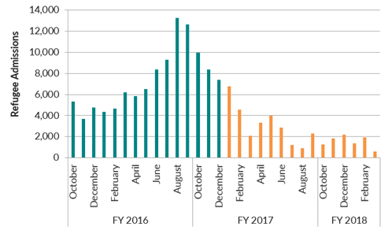
Reducing Refugee Admissions
•FY 2017 ceiling = 50,000
•FY 2018 ceiling = 45,000
•Obama-era ceiling = 110,000
•Increased vetting for ‘high-risk’ countries: Iraq, Egypt, Iran, Libya, Mali, North Korea, Somalia, South Sudan, Sudan, Syria, Yemen
Source: Migration Policy Institute https://www.migrationpolicy.org/article/even-congress-remains-sidelines-trump-administration-slows-legal-immigration
Notes:
September 2017 - President announced a further reduction in number of refugees to be admitted from 110,000 under Obama to 45K in FY2018 - no reason for the exponential drop in numbers - but undoubtedly tied to extreme vetting - and possibly a deliberate tactic to slow down processing so that fewer refugees enter the U.S.
Increased vetting: So far in FY 2018, 359 refugees from these ‘high-risk’ countries have been admitted → 59 times fewer than the same period last year (March 2018)
In 2016, near end of Obama presidency, the U.S. resettled 15,479 Syrian refugees (DOS)
In 2017, 3,024
So far this year we have 11 - Over the same period last year we had 790.
International Refugee Committee (IRC) projects that only around 21,000 refugees will be resettled in the US in FY 2018

Slide 16
Travel Ban
Travel Ban 3.0
President Trump’s third travel ban effort
First: January, 2017
Second: March, 2017
Third: Presidential Proclamation issued September 24, 2017
Went into effect on December 4, 2017
Current litigation against travel ban awaiting decision by Supreme Court
In Question: Trump’s statutory authority to issue the ban and the constitutionality of ban

Slide 17
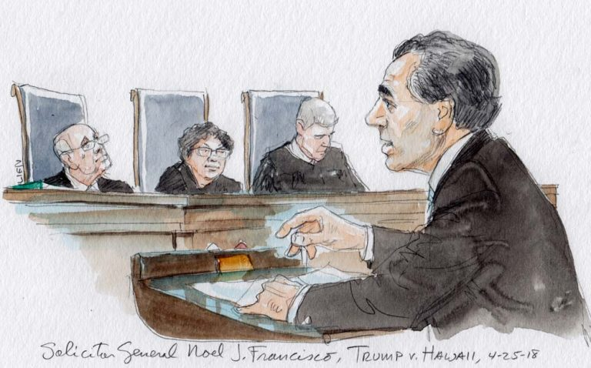
Judicial Responses to Travel Ban
The Supreme Court:
December, 2017: Supreme Court allowed travel ban to take full effect while legal challenges proceed
April, 2018: Supreme Court heard arguments for Trump v. Hawaii
Decision expected June, 2018
The lower courts: Two Federal Appeals Courts have ruled against the ban on grounds that it is discriminatory
Notes:
Supreme Court is likely to uphold the ban and rule in the government’s favor → concerns about second-guessing the president on national security issues
What are the justices saying?
RBG: Presidential authority → federal immigration laws only allow the president to ‘suspend’ the entry of travelers temporarily, giving Congress time to legislate solutions to any security issues
Sotomayor: laws already exist that address the security concerns outlined by the government to justify the ban
Kagan: Establishment clause → what would it take for a travel ban to be considered religiously discriminatory?
Roberts and Alito: worried about entangling courts in second-guessing the president’s national security determinations
Breyer: Waiver system → seemed open to upholding the ban if it could be demonstrated that the waiver system is more than just ‘window dressing’
Source: SCOTUSblog http://www.scotusblog.com/2018/04/argument-analysis-travel-ban-seems-likely-to-survive-supreme-courts-review/

Slide 18
Travel Ban: “In the Trenches”
M is a Syrian national, living and working in Dubai as a composer, conductor, violinist, and teacher. He created and runs a unique western-style orchestra which performs Arabic fusion music.
7/15/2016: M files I-140 self-petition for an EB-1 extraordinary ability immigrant visa
11/2/2016: USCIS approves I-140
1/30/2017: M submits application for immigrant visa to U.S Consulate
7/25/2017: M appears for immigrant visa interview at U.S. Consulate in Abu Dhabi
8/2017 - 1/2018: M gathers proof of his potential business relationships in the U.S.
1/2018: M returns to Consulate in Abu Dhabi with proof of his ties to U.S. employers
Consular Officers tell him his visa cannot be approved at this time,
but say “maybe, in the future” it could be granted
Notes:
A case-by-case waiver is available, but only for individuals who can show that being denied entry would cause undue hardship to the individual, that their entry would not pose a threat to U.S. national security or public safety and that their entry "would be in the national interest."
DOS Waiver Data: http://fingfx.thomsonreuters.com/gfx/reuterscom/1/60/60/letter.pdf
Applications for nonimmigrant and immigrant visas: 8,406 (submitted between December 8, 2017 and January 8, 2018)
Applicants qualifying for an exception: 128
Waivers approved (as of February 15): 2
According to Reuters, as of March 6, more than 100 additional waivers had since been granted
https://www.reuters.com/article/us-usa-immigration-travelban-exclusive/exclusive-visa-waivers-rarely-granted-under-trumps-latest-u-s-travel-ban-data-idUSKCN1GI2DW
During arguments before the Supreme Court for Trump v. Hawaii on April 25th, the government’s attorney cited figures as high as 400 approvals
M is a Syrian national, living and working in Dubai as a composer, conductor, performer, and teacher. He created and runs a unique western-style orchestra which performs Arabic fusion music.
On 7/15/16, M filed an I-140, self-petition for an EB-1 visa as immigrant of extraordinary ability.
On 11/2/2016, after responding to an RFE, USCIS approves M's I-140.
M paid the requisite immigrant visa fees, submitted the required civil documents, and completed his application for an immigrant visa on 1/30/17
The U.S. Consulate in Abu Dhabi schedules M for an immigrant visa interview on 7/25/2017. M affirmatively prepares and brings DS-5535. At the interview, the officer tells M that he must establish ties to US citizen family or a US citizen business.
From 8/2017 to 1/2018, M works on gathering proof of his potential business relationships in the U.S., including with performance venues and a nonprofit concept to promote peace and cross-cultural appreciation through cultural fusion music.
In 1/2018, M returns to the U.S. Consulate in Abu Dhabi with the proof of his ties to U.S. employers and is told that his visa cannot be approved at this time. The interviewer seemed sympathetic and gave M hope that "maybe, in the future" it could be approved.

Slide 19
Termination of TPS and DACA/End of Discretion
Notes:
Talk about discretion - stays of removal/deffered action pre and post order// motions to reopen

Slide 20
What is TPS (Temporary Protected Status)?
TPS is a temporary form of relief for individuals from certain countries designated by the Department of Homeland Security during times of extraordinary or temporary conditions such as armed conflicts or environmental disasters. (TPS is NOT residency, though many TPS beneficiaries have resided for lengthy periods of time in the U.S.)
Current countries that have TPS are El Salvador, Haiti, Honduras, Nepal, Nicaragua, Somalia, Sudan, South Sudan, Syria, and Yemen.
Congress passed legislation which allows TPS beneficiaries to have employment authorization and a temporary lawful status in the U.S.
TPS can be extended by the DHS, as it has been for many countries since 1990.
Notes:
There are approximately 200,000 Salvadorans and 60,000 Hondurans currently on TPS in the U.S. Most Salvadoreans are in DC area - 32
Honduras is the sixth country to lose temporary protected status since President Trump took office, meaning about 300,000 immigrants have been told they must leave the country next year, seek an alternative immigration status, or face deportation
PROBLEM IS: Most TPS holders were not formally admitted to the U.S. Most entered without inspection by illegally crossing a U.S. border. So, unless they travelled with Advance Parole (or travel authorization) they will not lawfully “admitted,” WILL NOT BE ELIGIBLE TO ADJUST THEIR STATUS IN THE U.S.

Slide 21
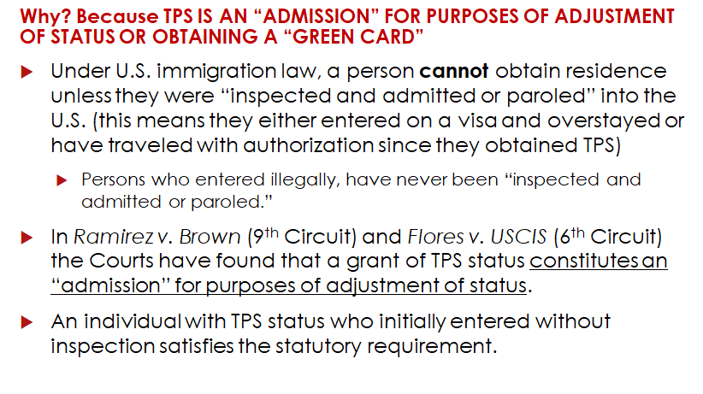
TPS Beneficiaries in the 6th and 9th Circuits Are Better Situated for “Admission.”
Notes:
TWO COURTS OF APPEALS HAVE HELD THAT 8 USC 1254a(f)(4) unambiguously requires that TPS holders are deemed to have been “inspected and admitted” for purposes of AOS and that the TPS statute specifically deems the tPS holder to be in valid non-immigrant status→ USCIS has a policy memo rejecting the plain language of the sttaute
Is a TPS recipient who entered without inspection and is living in a state within the jurisdiction of the Ninth or Sixth Circuits automatically eligible for adjustment?
No. Even under Ramirez and Flores, an applicant must be otherwise eligible for adjustment. Applicants for adjustment must satisfy three eligibility requirements under INA § 245(a): he or she must
• have been inspected and admitted or paroled into the United States;
• be eligible to receive a visa and not inadmissible to the United States; and
• have a visa is immediately available.
Additionally, an adjustment applicant cannot adjust if barred under any ground listed in INA § 245(c). Relevant here, an applicant is barred if he or she:
• worked without authorization prior to applying for adjustment;
• is in unlawful immigrant status on the date the adjustment application is filed; or
• failed to maintain a lawful status since entry into the United States. Immediate relatives are exempted from the unlawful status and employment bars. Id. 7 A modified rule is applied to certain employment-based adjustment applicants. INA § 245(k).
E

Slide 22
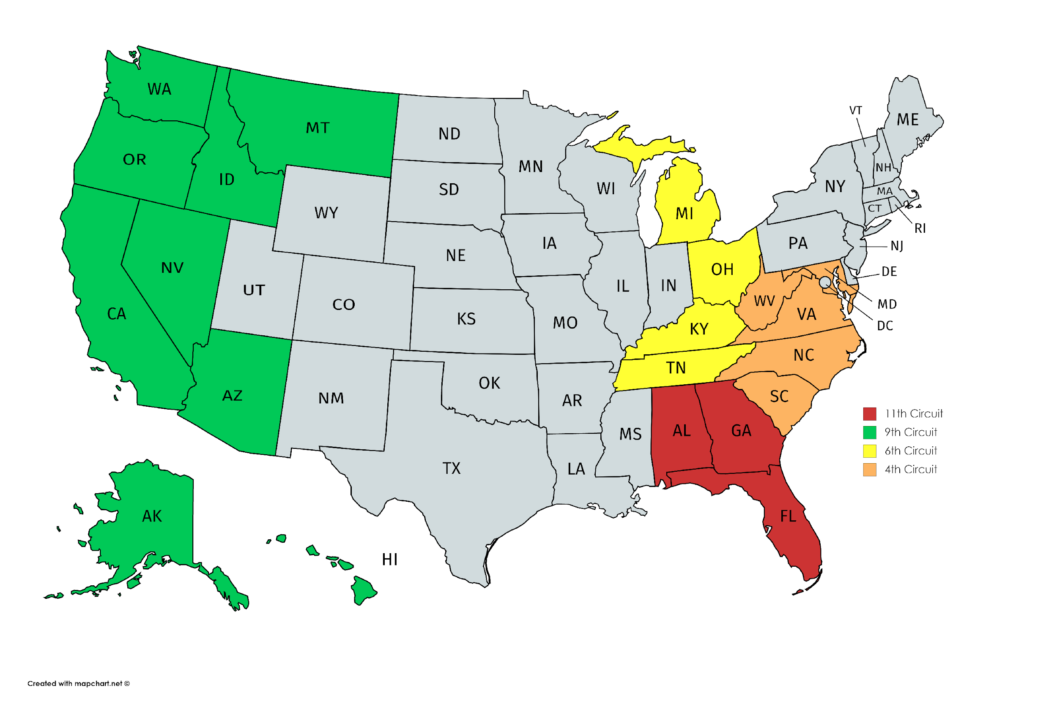
National Litigation Strategy:
Moreno v. Nielsen, 1:18-cv-01135 (E.D.N.Y., Feb. 22, 2018)
Notes:
The American Immigration Council, the Northwest Immigrant Rights Project, and several Temporary Protected Status holders filed a class action lawsuit against officials at the U.S. Citizenship and Immigration Services (USCIS) and U.S. Department of Homeland Security (DHS) in a federal district court in New York, challenging the government’s unlawful practice of depriving certain Temporary Protected Status (TPS) holders with close family relationships or employment in the United States from becoming lawful permanent residents.
The lawsuit alleges that Defendants’ policy:
Violates the Immigration and Nationality Act (INA) and Administrative Procedure Act (APA) because it refuses to recognize that TPS holders have been “inspected and admitted” for the purposes of adjudicating adjustment of status applications; and
Causes Defendants to fail to perform a non-discretionary duty (finding that TPS holders have been inspected and admitted when adjudicating adjustment of status applications).
This lawsuit also asks the court to:
Declare Defendants’ policy (and any adjustment of status decisions based on the policy) unlawful and order them to stop applying the policy;
Find that class members have been “inspected and admitted” for the purposes of their adjustment applications; and
Order Defendants to reopen class members’ adjustment applications that were denied based on the old policy and allow those class members the opportunity to have their applications reconsidered with the law properly applied.
As a result we are proceeding with employment based adjustment of status strategies in the hopes that the litigation will be successful

Slide 23
Legal Options For TPS Beneficiaries and Their Employers
Affirmative remedies: Adjustment of status (getting a “green card” or “lawful permanent residency”) through employment or family sponsorship; Law enforcement visas (U &T), I-601 Provisional waivers, Deferred Action to USCIS Director;
Defensive remedies for individuals in removal proceedings, and those with previous orders of removal.
NACARA
Asylum/Withholding/CAT
10 Year Cancellation of Removal due to extreme hardship to a U.S. citizen or LPR spouse, parent, or child
Motion to Terminate (Avetisyan)
Motion to Reopen due to Changed Circumstances (Asylum/Withholding/CAT) (request a stay of removal)
Motion to Reopen due to Extraordinary Circumstances (Ineffective Assistance of Counsel) (request a stay of removal)
Motion to Reopen sua sponte due to compelling equities (Avetisyan) (request a stay of removal)
Post-Order Deferred Action based on compelling humanitarian reasons (filed with ERO)
ONLY the U.S. Congress can legislate a permanent solution
Notes:
Affirmative Adjustment of Status/Consular Processing:
Family-based
Employment-based
245(i) Adjustment
For TPS holders NOT in removal proceedings: The countries where TPS beneficiaries are from face significant problems in terms of instability, crime, and political upheaval. Asylum may exist as an option for persons from those countries, but these claims will face significant challenges. Not least that asylum seekers must generally submit their applications within one year of entering the U.S. There are exceptions to this rule, including having been in another lawful status in the intervening years, but it will still present a challenge.
Asylum/Withholding/CAT
Eligible for U visa
Eligible for T visa
I-601 Provisional Waiver
Deferred Action based on compelling humanitarian reasons (filed with USCIS Director)
For TPS holders IN removal proceedings:
NACARA
Asylum/Withholding/CAT
10 Year Cancellation of Removal due to extreme hardship to a U.S. citizen or LPR spouse, parent, or child Motion to Terminate (Avetisyan)
For TPS holders with previous orders of deportation
Motion to Reopen due to Changed Circumstances (Asylum/Withholding/CAT) (request a stay of removal)
Motion to Reopen due to Extraordinary Circumstances (Ineffective Assistance of Counsel) (request a stay of removal)
Motion to Reopen sua sponte due to compelling equities (Avetisyan) (request a stay of removal)
Motion to Reopen due to lack of notice (automatic stay)
Motion to Reopen due to being within the 90/180 deadline (request a stay of removal)
Post-Order Deferred Action based on compelling humanitarian reasons (filed with ERO)

Slide 24
DACA
Approximately 694,000 Active DACA Recipients
Eligibility requirements:
Under age 31 and physically present in U.S. with no lawful status in June 2012, when program was enacted
Under age 16 upon arrival to United States
Physically present in U.S. with continuous residence since June 15, 2007
Currently in school/graduated or obtained a GED/honorably discharged veteran of the US Military
Not been convicted of a felony, a significant misdemeanor, three or more other misdemeanors, and do not otherwise pose a threat to national security or public safety.
Notes:
The Trump administration ended DACA Sept. 5, 2017, but said March 5, 2018, would be the official end date of the program. DACA recipients whose work permits were set to expire by that date were allowed to apply for renewal—but only if they did so by Oct. 5, 2017.
Then the federal courts started to weigh in. A federal judge in California on Jan. 9, 2018 ordered that U.S. Citizenship and Immigration Services start accepting DACA renewal applications from everyone. A second federal judge in Brooklyn, N.Y., later issued a similar order. Both cases are pending in their respective federal appeals court following the U.S. Supreme Court’s Feb. 26, 2018 refusal to hear the Justice Department’s direct appeal from the California case.
The court orders leave DACA in place for now, but they could be overturned on appeal. They also don’t require USCIS to accept any applications from immigrants applying for DACA for the first time.
Back Door denials of DACA → extremely honerous Request for Further Evidence. Received one this week. In regards to the Physical presence requirement/// there was a three month period where we submitted bank statements to show physical presence along with hundreds of pages of other documents. USCIS said that because they were for a joint account, it wasn’t sufficient evidence.

Slide 25
DACA Litigation
Pro-DACA
U.S. District Court for Northern District of California: preliminary injunction
Government must continue accepting DACA renewals
Appeals process
U.S. District Court for Eastern District of New York: second preliminary injunction
U.S. District Court for the District of Maryland: third preliminary injunction
Government must not use DACA recipients’ personal information for enforcement purposes
U.S. District Court for the District of Columbia: final judgment
full reinstatement of DACA program: Government must accept renewals and first-time applications
Stayed for 90 days
U.S. District Court for Southern District of Texas: motion for preliminary injunction to halt DACA altogether
Anti-DACA
Notes:
Pro DACA
California: Regents of the University of California v. Department of Homeland Security
Judge William Alsup issued the injunction January 9, 2018
government requests cert. before judgment before SCOTUS on January 18, 2018
SCOTUS denies cert. on February 26, 2018 → appeals process will proceed as normal
Oral Arguments hard by Ninth Circuit Court of Appeals on May 15, 2018
New York: Batalla Vidal v. Nielsen and State of New York v. Trump
Batalla Vidal: brought by six DACA recipients living in NYC
State of New York: brought by a coalition of 17 attys general
Feb. 13, 2018 Injunction: same in scope as CA: claims that the Trump administration ended DACA in a way that was arbitrary and capricious, and therefore unlawful
Government has appealed to Second Circuit Court of Appeals → waiting for oral argument to be scheduled (as of 5/9/18)
Maryland: CASA de Maryland v. Dept. of Homeland Security
March 5, 2018: Dismissed most of the plaintiffs’ claims, including that DACA termination was unlawful. BUT the court did grant a nationwide preliminary injunction to DACA recipients on thir claim regaerding the sharing and usage of the information DACA recipients have provided to the government
Ordered to not share private information for enforcement purposes against DACA recipients or their family members (barring national security exceptions)
If DHS wants to use DACA recipients’ information, they must submit case-by-case requests to the court for confidential reviews
DC: NAACP v. Trump and Trustees of Princeton v. United States of America
April 24, 2018, Judge John Bates issued a final judgment that grants:
in part, summary judgment in favor of DACA recipients and organizations that sued to reverse the program’s termination
orders that the memorandum terminating the program be vacated
this decision would reinstate the status quo prior to the September 5 announcement → government would have to accept first-time applications and renewals
BUT, the court stayed its own order for 90 days to allow the government to better explain its argument for terminating DACA
would go into effect July 23, 2018
gov. can appeal or issue a new DACA-recission memo → cancel Judge Bates’ decision → could mean that the government will not have to accept first-time applications
Anti-DACA
Texas v. Nielsen
May 1, 2018: Texas, Alabama, Arkansas, Louisiana, Nebraska, South Carolina, West Virginia filed lawsuit against the federal government
motion for preliminary injunction to halt the 2012 DACA program from operating during the pendency of the lawsuit, for both new and renewal applications
argue that DACA is unlawful: violated procedural and substantive requirements of the Administrative Procedure Act, as well as the Take Care Clause of the Constitution
acting now because current litigation indefinitely prolongs the program
Judge Andrew Hanen → same judge who blocked implementation of DAPA, and a DACA extension (U.S. v Texas, 2015)
upheld by 5th circuit court of appeals and left in place by a split court 4-4 nonprecedential decision by SCOTUS
May 8, 2018: 23 individual DACA recipients asked to intervene formally in this case as defendants
Initial scheduling conference set for July 31, 2018
Source: National Immigration Law Center (NILC) report, “The Current Status of DACA Litigation” https://www.nilc.org/issues/daca/status-current-daca-litigation/

Slide 26
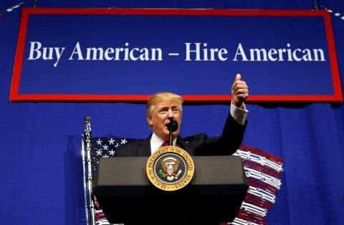
Buy American/
Hire American
Executive Order
Notes:
On April 18, 2017, President Trump signed the Buy American and Hire American Executive Order, which seeks to create higher wages and employment rates for U.S. workers and to protect their economic interests by rigorously enforcing and administering immigration laws. The agreement also comes with notable trade implications:
BAHA instructs the Secretary of Commerce and the United States Trade Representative to assess the impacts of all free trade agreements and the WTO's GPA (gov. procurement agreement) on the operation of Buy American Laws and provide recommendations to
strengthen implementation of the laws;
require agencies to minimize the use of waivers;
Require waivers to be made by the head of the agency authorizing the procurement; and
obligate a procuring agency to analyze whether the price advantage of a foreign-produced product is due to dumped or subsidized iron, steel, or manufactured goods. As a result of this executive order, the United States may seek to renegotiate its commitments in the GPA or government procurement agreements in FTAs. This could take the form of terminating or reducing some U.S. commitments or seeking further access from trading partners for U.S. suppliers. Either way, U.S. trading partners may seek concessions in return. Congress has established trade promotion authority (TPA) negotiating objectives to shape the Administration's negotiating stance and may conduct oversight of any negotiations. Talk about this more with NAFTA negotiations
In addition, DOS made BAHA-related changes to the FMA, and the DOL and DOJ have stepped up monitoring and enforcement of H-1B employees. Importantly, the BAHA executive order also directs DHS, in coordination with other agencies, to advance policies to help ensure H-1B visas are awarded to the most-skilled or highest-paid beneficiaries.
Implications: impact the nation’s ability to attract innovators, and the ability of US employers to supplement their workforce with skilled foreign employees

Slide 27
Adjudication of Benefits
Increased scrutiny for all benefits applications
Interviews for employment-based green card applications (and all family-based cases)
Increased questioning re: basis for permanent residence in citizenship cases
Delays across the board
Notes:
USCIS case processing backlog
USCIS generally defined “backlog” as “the number of pending applications that exceed acceptable or target pending levels for each case type,” less the number of pending applications that cannot be completed due to statutory caps or other bars
Stats:
In FY 2016, USCIS received approximately 8.070 million applications for benefits, a 5 percent increase over FY 2015 and a 34 percent increase over FY 2012.
The number of pending petitions across major product lines, including immigrant petitions for relatives, investor-based petitions and applications, adjustment of status to lawful permanent resident, naturalization, and humanitarian-based programs have grown significantly between FY 2016 and FY 2017.
The backlog of asylum applications, which “has grown by more than 1750 percent over the last five years,” logged in at 311,000 as of January 21, 2018.
At the end of FY 2017, a total of 5.6 million applications and petitions were pending with USCIS as compared to 4.3 million at the end of FY 2016.
overall increase in the length of time it takes to adjudicate 1-140s, I-485s, I-765s, I-131s, I-539, I-90
natz processing times vary widely depending on jurisdiction
On a February 27, 2018, CIS Ombudsman’s stakeholder teleconference, it was reported that approximately 24 percent of EAD applications are taking longer than 180 days to process
AILA: Therefore, a significant percentage of EAD applicants, even those who benefit from an automatic extension of employment authorization, risk losing their jobs or their ability to work for several months. This creates significant hardships for families that depend on that income and employers who are forced to locate and train new workers.
Challenges to Stakeholders
Infopass shortages
Deficiencies in USCIS customer service tools → hotline, online case status information
Incomplete/Outdated processing time reports
restrictions on Congressional Liaison → new requirements, ‘red tape’
could bar congressional staffers from speaking with attorneys of record
AILA: The lack of timely and accurate data, the inability to obtain substantive information on a pending application or petition, and the creation of bureaucratic hurdles to seeking congressional assistance erodes public trust, frustrates the ability of affected stakeholders to make personal and professional plans, and elevates stakeholder anxiety surrounding the immigration process
Source: AILA Report, “Deconstructing the Invisible Wall”

Slide 28
H1B Visas
Each year, 85,000 H-1Bs, which are valid for three to six years, are available to companies, according to a ceiling set by Congress.
Three main requirements:
You must pay sponsored workers certain wages, as determined by the Dept of Labor.
The person you are sponsoring must have a university degree, in a specific topic.
The job you are offering must require that same degree.
Notes:
H1B Background:
It’s the most common type of visa for working in the US. About half a million people currently hold this status
Each year, 85,000 H-1Bs, which are valid for three to six years, are available to companies, according to a ceiling set by Congress.
It has three main requirements:
You must pay sponsored workers certain wages, as determined by the Dept of Labor.
The person you are sponsoring must have a university degree, in a specific topic.
The job you are offering must require that same degree. For example, a law degree for a lawyer, and accounting degree for an accountant, a computer science degree for a computer systems analyst.

Slide 29
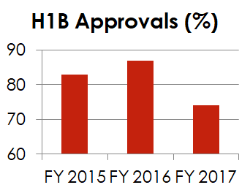
Challenging Climate at USCIS for Employers Sponsoring Foreign Workers
Intense Scrutiny of H1B petitions
Increased RFE issuance
Target entry-level positions
Elimination of Deference for Extension Requests
Substantial Increase in Processing Times
Potential Elimination of Work Authorization for H4 Spouses
Notes:
BAHA Policy Changes & Consequences
The current Administration has been looking closely at the H1B category, because they are very worried about H1B workers taking jobs from US workers. It has become increasingly difficult to get an H1B in the past year.
The BAHA executive order is aimed at ensuring the visas “are awarded to the most-skilled or highest-paid” applicants.
The order itself did not implement changes but directed agencies to suggest reforms.
More intense scrutiny
Between Jan. 1 and Aug. 31 2017, USCIS issued 85,000 RFEs to H-1B visa petitions - a 45% increase over the same period the previous year.
RFEs issued at a greater rate in 2017 than at any time in the Obama administration
H1B renewals receive same level of scrutiny as initial applications
Heightened evidentiary requirements for all H-1B petitions involving third-party worksites → Feb. 2018
Higher costs to employers associated with RFE’s are likely to discourage employers from hiring foreign workers, especially at lower specialization/skill levels
Increased Processing Times (Graph): Approval Rate for FY 2017 is so much lower (74% compared to 87% the previous year) because tens of thousands of petitions from FY 2017 have yet to be adjudicated
Trump administration is targeting entry-level jobs offered to skilled foreigners: say that the salary should be higher because the job is too complex or that the job does not count as a “specialty” occupation
Plan to End work authorization for H1B spouses (H4 visa holders) in June 2018
More than 71,000 spouses granted work authorization under this Obama-era policy between 2015 and 2017
94% are women, 93% are Indian nationals
AILA: “Instead of protecting American jobs, this move would only serve to force thousands of individuals who are legally in the United States to abandon their careers and professional goals, forcing them back into a domestic role, and imposing unnecessary economic and personal hardships on families.
also may act as a deterrent to some high-skilled workers who would not relocate to the US if their spouses were ineligible to work
Source: Reuters, “Trump Administration Red Tape Tangles Up Visas for Skilled Foreigners, Data Shows” https://www.reuters.com/article/us-usa-immigration-employment-insight/trump-administration-red-tape-tangles-up-visas-for-skilled-foreigners-data-shows-idUSKCN1BV0G8

Slide 30
NAFTA Renegotiations

Slide 31
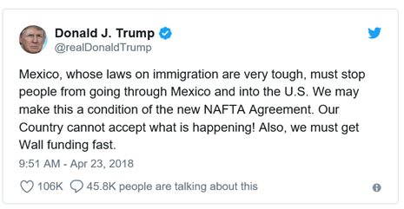
NAFTA Renegotiations
May 17, 2018: Paul Ryan’s deadline to consider the deal in the House this year
May 14, 2018: Wall Street Journal,“Bevy of Issues Continues to Complicate NAFTA Negotiations”
October 23, 2017: Sen Grassley asked Amb Lighthizer to renegotiate “guest worker” provisions
To date, negotiations have not involved legal immigration provisions; the President has focused on undocumented migration from Mexico:

Slide 32
NAFTA’s Immigration Provisions:
What Could Happen
TN (Trade NAFTA)
63 professions incl nurses and other health care occupations, scientists, university professors, engineers, lawyers, accountants and economists
No “cap” or annual limit on admissions
Would need implementing legislation to reinstate if NAFTA terminated
E1 (treaty trader) and E2 (treaty investor)
would need implementing legislation to reinstate
L1 (intracompany transferee)
could eliminate border processing
B1 (business visitor)
No real changes

Slide 33
EB5 Investor
Green Cards

Slide 34
About the EB-5 Investor Green Card
Created by Congress in 1990 to stimulate the U.S. economy through job creation and capital investment by foreign investors.
All EB-5 investors must invest in a new commercial enterprise (“any for-profit activity formed for the ongoing conduct of lawful business”)
Job Creation Requirements
Direct investment – 10 full time direct jobs
Regional center – 10 full time direct or indirect jobs
Capital Investment Requirements
Direct investment - $1 million
Targeted Employment Area (High Unemployment or Rural Area) or Regional Center - $500,000
§ TEA = rural area or an area which has experienced unemployment of at least 150 percent of the national average rate.
Source of funds -The immigrant investor must establish that he or she is the legal owner of the capital invested.

Slide 35
What’s Next for the EB-5 Program?
Direct investment program created in 1990 as a permanent program.
Regional center program, allowing indirect as well as direct job creation, continues to be extended on short term basis. Most recent extension to September 30, 2018.
Draft EB-5 regulations currently under review @ OMB. Could be enacted any time.
Focus on:
Targeted Employment Area (TEA) designation.
Increases in investment amounts
In April 2018 Sens. Grassley & Leahy, Rep. Goodlatte wrote a joint letter to DHS Secretary urging swift implementation of these regulations.

Slide 36
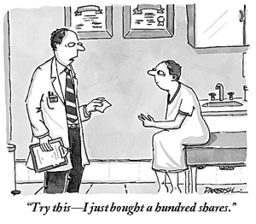
The Politics of EB-5 Visas: Conflict of Interest? Kushner Cos being investigated by SEC for its use of the EB-5 program.
Notes:
“The Kushners' use of EB-5 visas to raise cash to finance developments came to broad attention in May last year, when Kushner’s sister, Nicole Kushner, spoke at a publicly advertised event in Shanghai to attract Chinese investment into a two-tower luxury apartment complex in New Jersey, called One Journal Square, being developed jointly by Kushner Cos and KABR Group. The company later apologized for mentioning Jared Kushner's name while wooing investors.”
Source: SEC Probing Kushner Cos Use of Wealthy Investor Visas, Wall Street Journal, Jan. 6, 2018.

Slide 37
174 EB-5 visas issued to Indians in FY2017
increase of about 17% over FY2016.
Demand continues to grow: In October and November 2017, USCIS received another 307 EB-5 applications from Indians.
China remains the biggest EB-5 user, accounting for more than 75% of the 10,000 visas issued each year, but demand is declining due to a substantial backlog which has created a wait of 10 years or longer for Chinese applicants.
The Politics of EB-5: India & China

Slide 38
Contact Information
8737 Colesville Road, Suite 950
Silver Spring, MD 20910
Tel: + 1 301 917 6900 Fax: + 1 301 424 0929
byoung@hyimmigration.com
www.hyimmigration.com
4922 Fairmont Ave., Suite 200
Bethesda, MD 20814
Tel: + 1 240 403 0913 Fax: + 1 240 453 0915 Sandra@grossmanlawllc.com
www.grossmanlawllc.com

Slide 39
THANK YOU!
PRESENTED BY:
BECKI L. YOUNG, ESQ., HAMMOND YOUNG IMMIGRATION LAW, LLC SANDRA GROSSMAN, ESQ., GROSSMAN LAW, LLC
Covington & Burling, LLP May 16, 2018
Hammond Young Immigration Law, LLC © 2018

